Slide 1
Wakefields:
Laser, toilet science, and gamma-ray bursts
Toshi Tajima
Norman Rostoker Chair, UC Irvine
AAPPS18
Kanazawa, Japan
Nov. 12, 2018

Slide 2
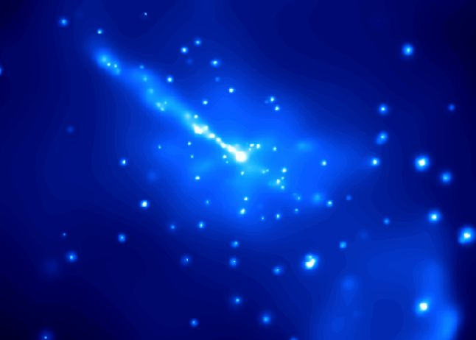
Acknowledgements of collaboration and my sincere thanks to:
G. Mourou*, K. Nakajima, X. Q. Yan, D. Farinella, F. Dollar, W. Brocklesby, S. Steinke,
B. Barish**, M. Downer, T. Ebisuzaki, A. Mizuta, K. Abazajian, M. Spiro, M. Teshima,
K. Mima, Y. Kato, Y. Kishimoto, S. Bulanov, R. X. Li, A. Necas, S. Gales, M. Leroy,
T. Massard, Y. Brechet, M. Kikuchi, F. Tamanoi, S. Hakimi, S. Nicks,
X.M. Zhang, Y. Shin, P. Taborek, A. Caldwell, K. Shibata, R. Matsumoto,
⁺J. M. Dawson, ⁺N. Rostoker
* 2018 Nobel, ** 2017 Nobel

Slide 3
abstract
Wakefield: robustly elevated energy state, relativistic coherence, Higgs’ state of plasma ←→Field Reversed Configuration: robustly elevated energy state (elevation → Landau-Ginzburg-like potential)
Laser acceleration drove (1979) laser innovations:
CPA (1985)*, RC (2004), CAN laser (2013), TFC (2014)
3. Nature prevalently creates wakefields: AGN accretion disk and jets
Fermi acceleration → Wakefields acceleration
4. Gamma-ray bursts (Blazars): signature of wakefields
GRB : sometimes accompanied by Gravitational Waves (GW)**
5. CAIL and Toilet Science
6. New technology thin film compression (TFC) →
Leading to a new innovation X-ray LWFA
7. “TeV on a chip” (X-ray LWFA); coherent γ-ray laser; new
zeptosecond science; medical (and other compact) accelerators

Slide 4
Elements of Wakefields

Slide 5
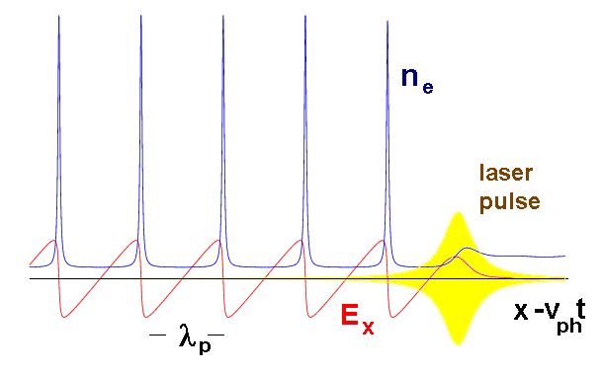
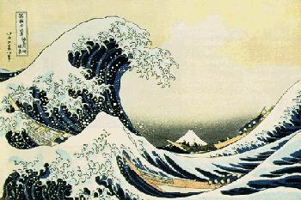
Laser Wakefield (LWFA, 1979):
Wake phase velocity >> thermal speed (v_{ph} >> v_{th} ) Tsunami phase velocity becomes ~0,
maintains coherent and smooth structure causes wavebreak and turbulence
vs
Strong beam (of laser / particles) drives plasma waves to saturation amplitude: E = mωv_{ph} /e
No wave breaks and wake peaks at v≈c
Wave breaks at v＜c
← relativity
regularizes
(relativistic coherence)
Relativistic coherence enhances beyond the Tajima-Dawson field E = mω_{p}c /e (~ GeV/cm)

Slide 6
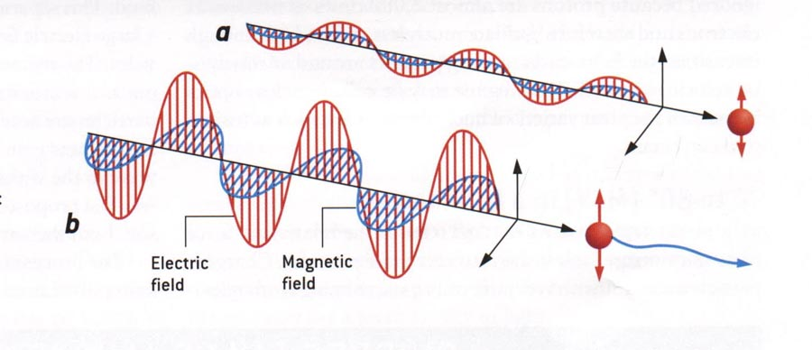
Relativistic nonlinearity under intense laser
(1979)
Plasma free of binding potential , but its electron responses
forms its sturdy “spine”:
a) Classical EM : v_{os}<<c,
b) Relativistic EM: v_{os}~c
a₀<<1: δx only
a₀>>1: δz >> δx
x
z
nonlinear δz~a_{o}²
linear δx~a_{o}
Needs for relativistic laser intensity a₀ = eE / mωc > 1 (1979) → high field science CPA* (1985)

Slide 7
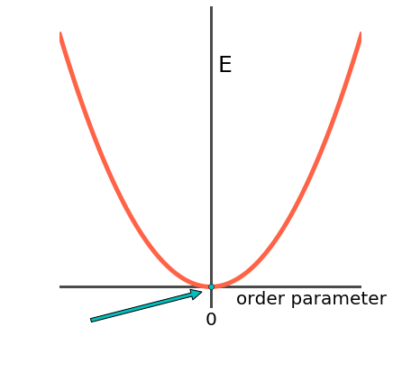
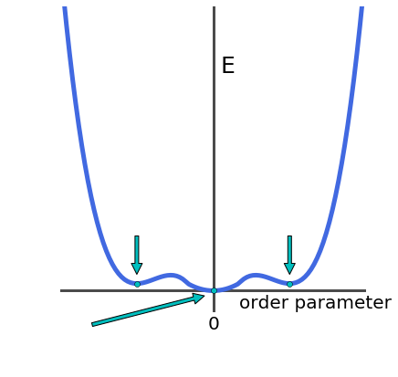
Thermal plasma vs. Wakefields (and Higgs)
Trivial vacuum vs. Laundau-Ginzburg potential → BCS → Nambu → Higgs vacuum
Thermal plasma w/ Landau damping → wakefields , plasma with elevated energy
Thermal plasma → Field Reversed Configuration plasma
[Landau damping: decay of excited waves to equilibrium (left picture)]
Wakefield: no damping; distinct excited stable state ←no particles to resonate (@ v_{ph} >> v_{th})
= plasma’s elevated Higgs state , “onigokko (hide ‘n seek)” state , or “spined” state
| 0 > vs. | H > ( cf . | H > → | 0 > )
thermo-equilibrium wakefield state tsunami onshore
Tajima, Nakajima, Mourou*, RNC (2017)
Landau-Ginzburg potential
Thermal potential
*
*

Slide 8
Theory of wakefield toward extreme energies
(when 1D theory applies)
In order to avoid wavebreak,
a₀ < γ_{ph}^{1/2} ,
where
γ_{ph} = (n_{cr} / n_{e} )^{1/2}
←theoretical
←experimental
n_{cr} =10²¹
n_{e} = 10¹⁶
dephasing length
pump depletion length

Slide 9
CAN laser and Laser Collider

Slide 10

Energy gain
VS
Plasma density
1 TeV
1000
GeV
n_{e}=3x10¹⁵ cm⁻³, L_{acc}=245m
100
100 GeV
n_{e}=1.2x10¹⁶ cm⁻³, L_{acc}=12m
IZEST 100 GeV Ascent Collaboration:
Design by Prof. Nakajima
40GeV
n_{e}=3x10¹⁶ cm⁻³, L_{acc}=5m
10
PETAL design
Energy gain
4.2 GeV
BELLA-LBNL
CoReLS-IBS
TEXAS
3D PIC simulation
LBNL
SIOM
SIOM
LLNL
Experimental data
1
CAEP
MPQ
RAL
LLNL
7x10¹⁷ cm⁻³
Plasma density
0.1
cm⁻³
10¹⁹
10¹⁸
10¹⁷
10¹⁶
10¹⁵

Slide 11


Coherent Amplification Network
Efficient (>30%), high rep rated (~kHz –MHz), light, digitally controllable
CAN laser makes laser collider possible
See Nakajima et al. (2018)
Also indispensable for toilet science (later)
Electron/positron beam
Transport fibers
~70cm
Mourou*, Brocklesby, Tajima, Limpert,
Nature Photonics (2013)

Slide 12
Nature’s Natural Wakefields:
jet wakfields driven by
disk MRI instability
Ebisuzaki et al. Astropart. Phys. (2014)

Slide 13
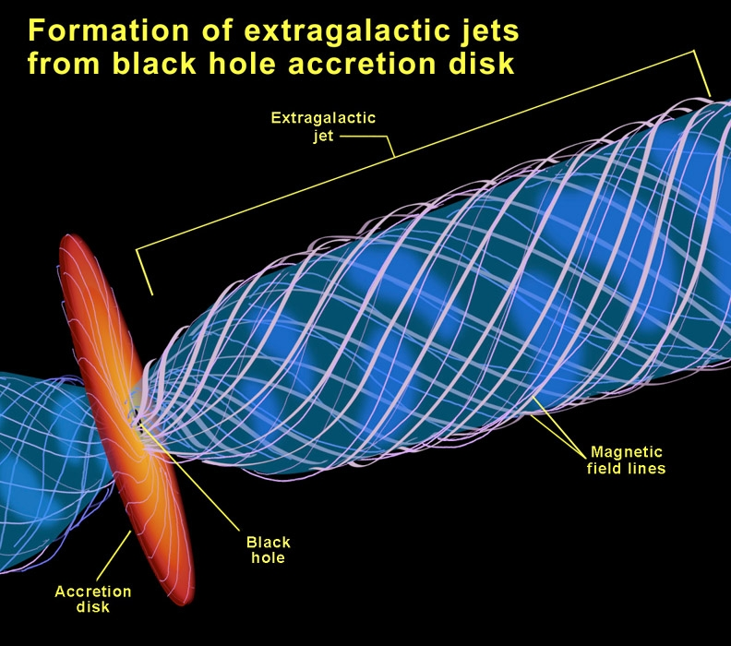
EM Waves
EM Waves
Alfven Waves
Γ＝１０～３０
Wake at bow of Alfven Pulse
Bow Wake Acceleration

Slide 14
Anti-correlation between
Luminosity and Power index from Blazars
Anti-correlation of
Luminosity L of gamma-ray and
Power index p in time
↑
Wakefield theory anticipated(Ebisuzaki-Tajima 2014)
Power index p vs.
Luminosity L for several
Blazars (more in Abazajian
et al. arXiv 2018)
p
L
←p=2

Slide 15
Luminosity of gamma ray emission and spectrum
AGN 3C454.3 with M = 10⁷ M
Luminosity L
Strong accretion
→ strong wakefield
time
Spec. Index p
←p=2
Ideal episode for wakefield:
index p = 2,
Otherwise p > 2
(Mima, Tajima, Hasegawa 1991; Takahashi, Hillman, Tajima 2000, Ebisuzaki, Tajima 2014)
Luminosity L

Slide 16
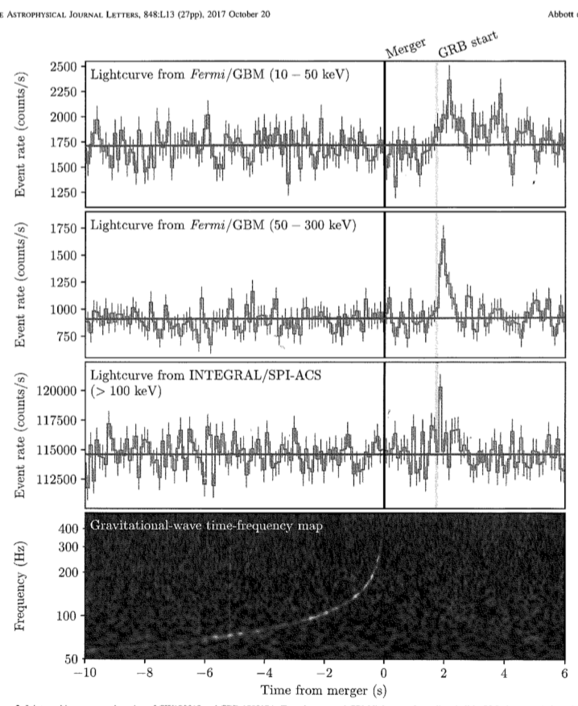
Gravitational wave and Gamma bursts
Fermi satellite x LIGO
- gamma bursts →
- GW synchronize precedes gamma bursts
see (Ebisuzaki et al, 2014)
Neutron star-Neutron star collision
→ similar wakefields
(Takahashi et al. 2000)
Simultaneous Gravitational Waves**
(Barish** at UCI, 2018) →
(delayed by ~ 1 sec)
**) Nobel in Physics (2017)
Abbott et al. ApJ (2017)

Slide 17
Thin Film Compression and
CAIL, and Toilet Science
Mourou* et al. (2014)

Slide 18
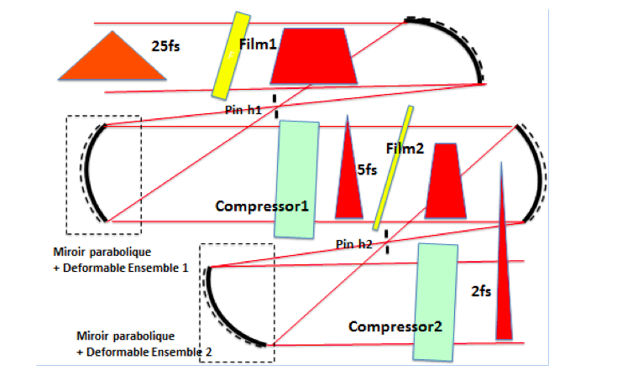
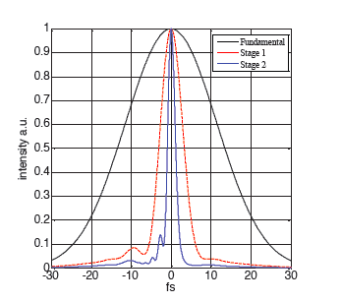
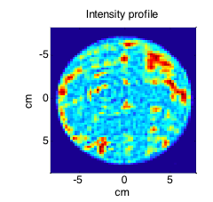
Single-cycle laser (new Thin Film Compression)
Laser power ＝ energy / pulse lnegth
1PW
Optical nonlinearity of thin film → pulse frequency width bulge, pulse compression
10PW
G. Mourou*, et al. Eur. Phys. J. (2014)

Slide 19
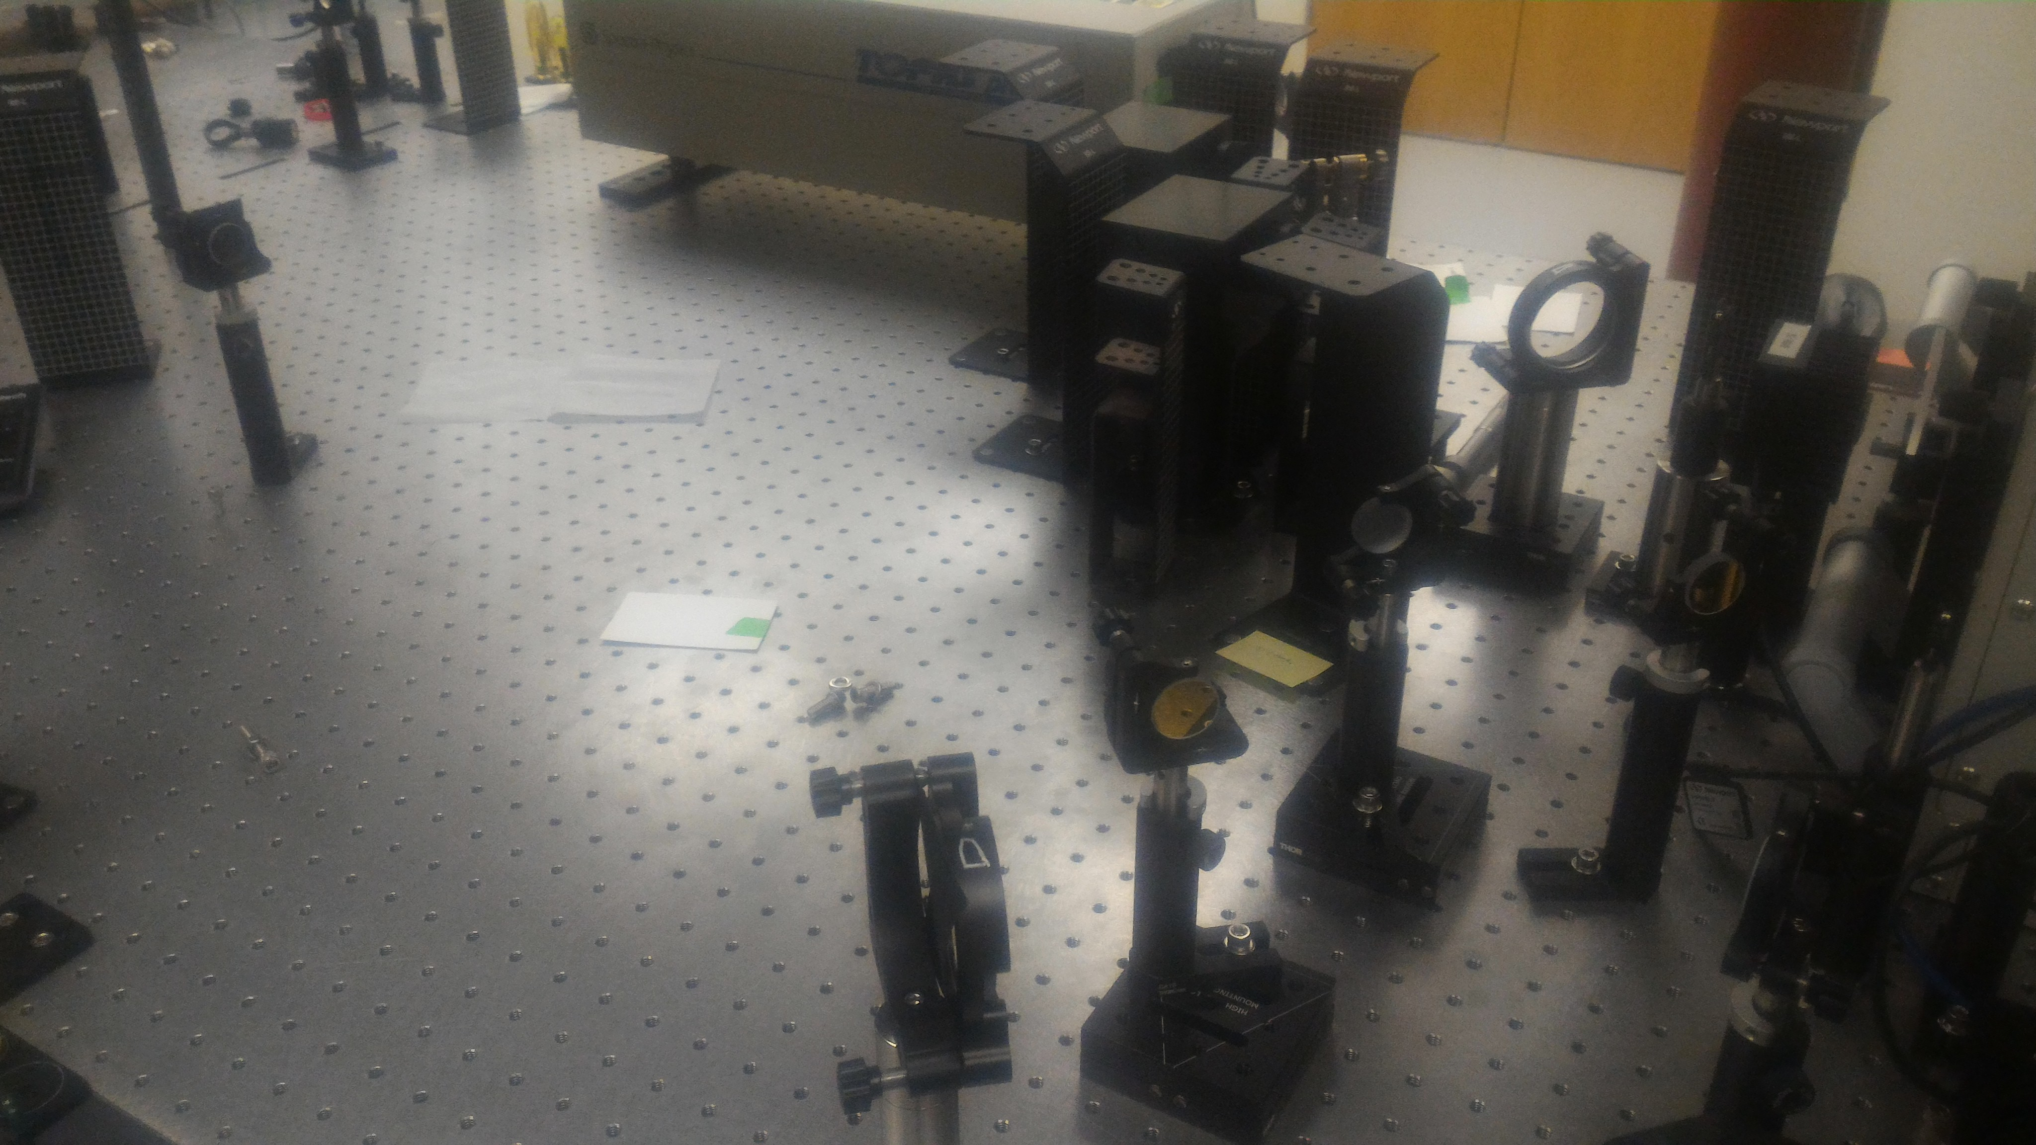
CM
W
TFC
GM
UCI TFC
GM
W
CM
Chirped Mirror: CM
Gold Mirror: GM
Wedge: W
TFC Target (Fused Silica): TFC
F. Dollar, D. Farinella, T. Nguyen, TT

Slide 20


Adiabatic (Gradual) Acceleration
from #1 lesson of Mako-Tajima problem (1978)
Accelerating structure
↓
Inefficient if suddenly accelerated
protons
↑
↓
Accelerating structure
↓
Efficient when gradually accelerated
Lesson #1: gradual acceleration → Relevant for ions

Slide 21
Adiabatic (Shinkansen) acceleration (2)
Thick metal target
Most experimental configurations of proton acceleration(2000-2009)
c
laser
protons
electrons
Innovation (“Adiabatic Acceleration”)
(CAIL, 2009-)
= Method to make the electrons
within ion trapping width
c
slow
Graded, thin (nm), or clustered target and/or circular polarization

Slide 22
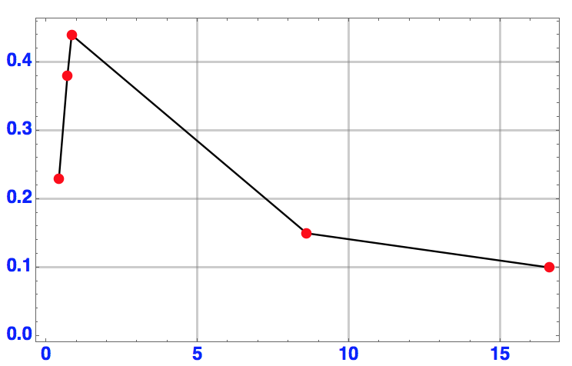
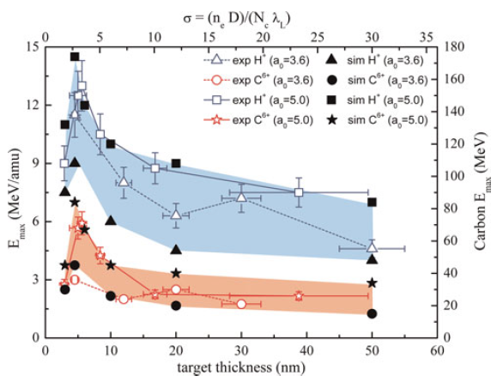
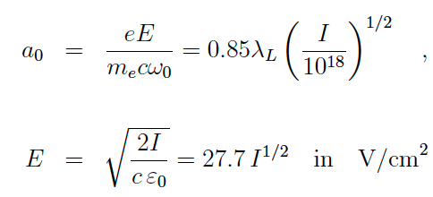

Deuteron energy vs. thickness of foil
Target thickness scales with a₀
Coherent Acceleration of Ions by Laser (CAIL)
Energy
target thickness [normalized to laser intensity]
Experiment:
Our simulation
Steinke (2010)
Optimum parameters (sweet-spot) for ion acceleration at
Necas (2018)

Slide 23
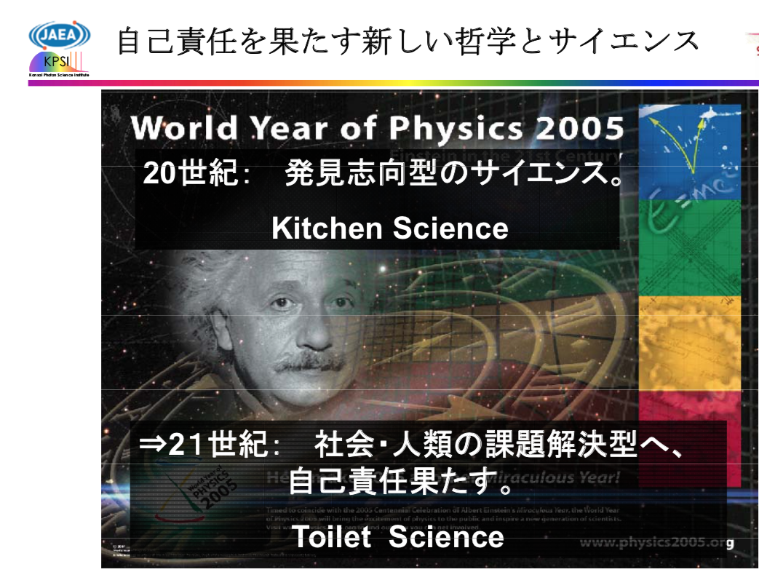
New Philosophy and Science
to Fulfill Self-responsibility
20th Century:
Science of Discovery
→
21st Century:
Toilet Science:
Responsive to
societal issues
self-inflicted
Tajima
(Jan. 18,2005)

Slide 24
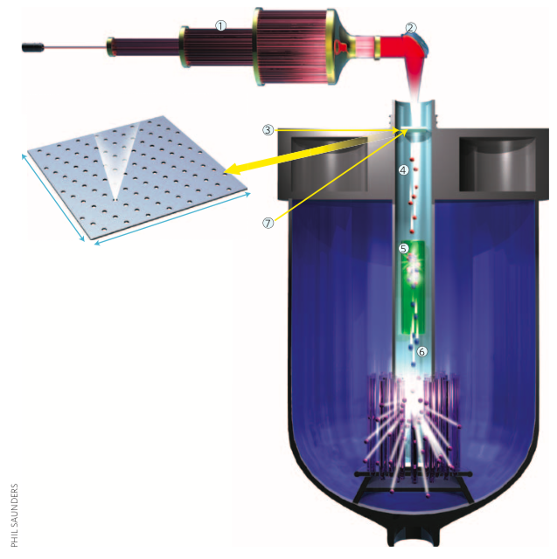
Toilet Science with CAN laser :
Coherent Acceleration of Ions by Laser (CAIL)
CAN laser
thin target compression
And irradiation of
Nanometric film for CAIL
Transmutator of nuclear waste
by neutrons
(Tajima, Necas, Mourou*, Gales,
Leroy, 2018)
generated with deuteron
acceleration by CAIL
(Tajima, Yan, Habs, 2010)
Mourou*, Brocklesby, Tajima, Limpert
: Nature Photon. (2013)

Slide 25
X-ray LWFA in Nanostructure
Tajima, EPJ 223 (2014)
Zhang et al. (2016)

Slide 26
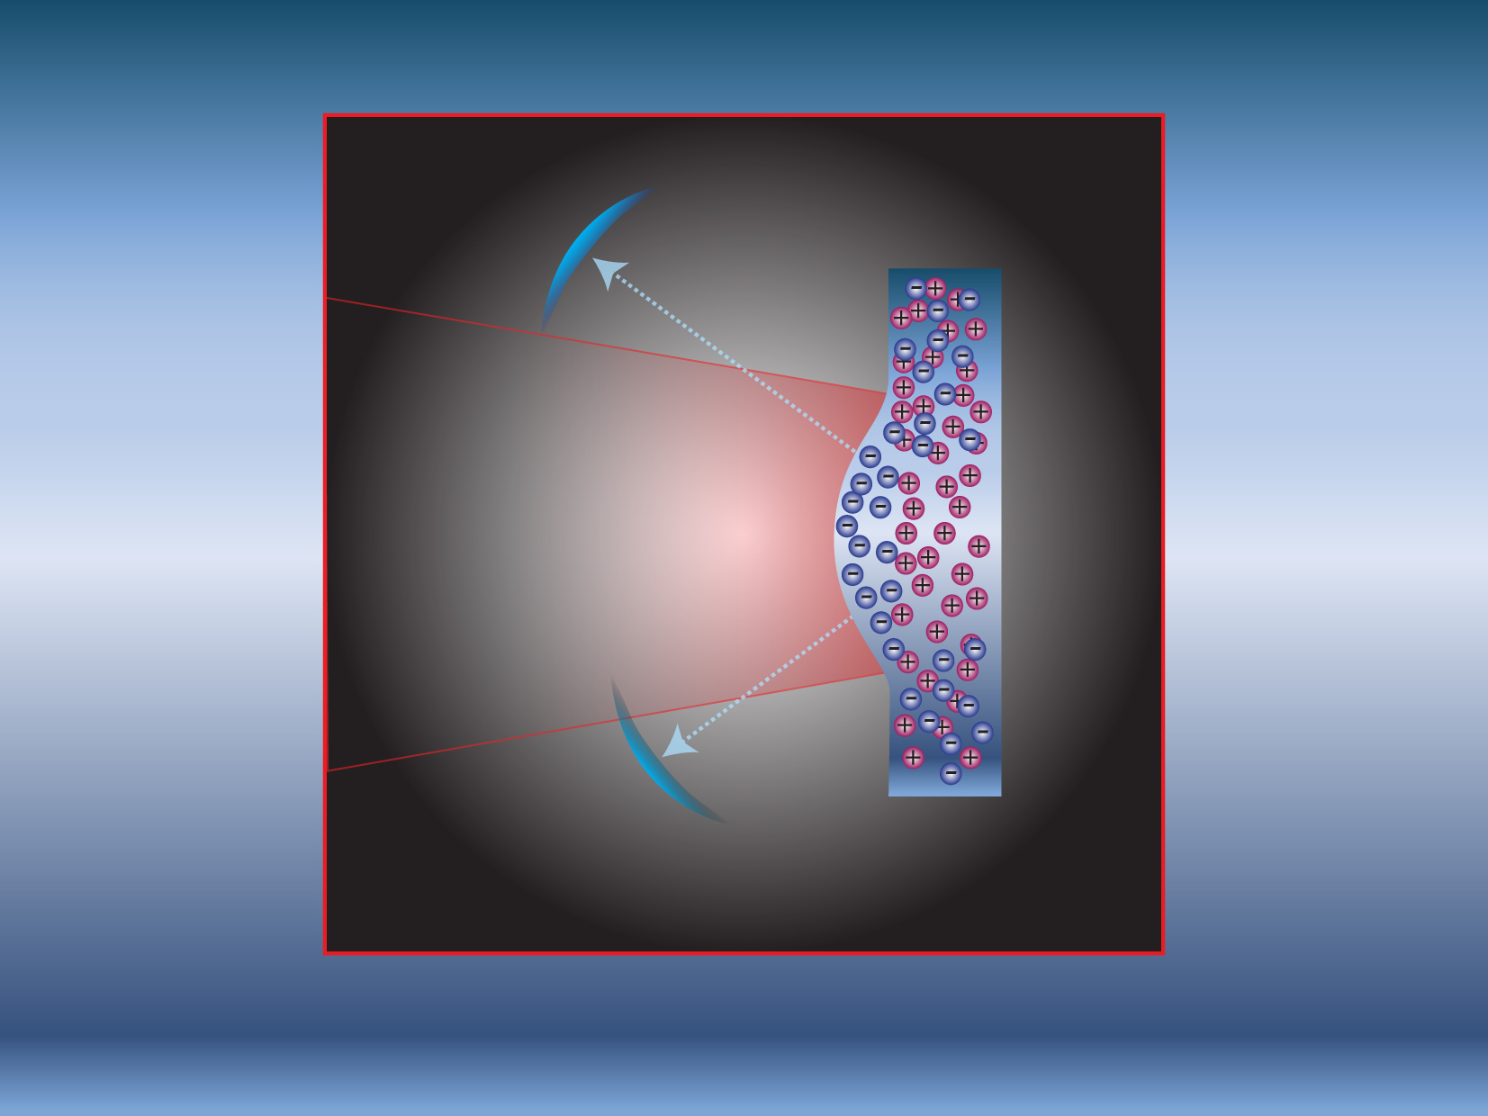
Relativistic Compression

Slide 27
Thin Film Compression (TFC) into a
Single-Cycled Laser Pulse
Mourou* , Brocklesby, Tajima, Limpert (2014)

Slide 28
Porous Nanomaterial: rastering possible
Nano holes:
reduce the stopping
power
keep strong wakefields
Marriage of nanotech and
high field science
Spatia (nm), time(as-zs), density 10²⁴ /cc), photon (keV) scales:
Transverse and longitudinal structure of nanotubes: act as
e.g., accelerator structure (the structure intact in time of ionization, material breakdown times fs > x-ray pulse time zs-as)
Porous alimina on Si substrate
Nanotech. 15, 833 (2004);
P. Taborek (UCI): porous alumina
(2007)

Slide 29
Fermilab/UCI efforts on nanostructure wakefield acceleration

Slide 30
X-ray wakefield acceleration
in nanomaterials tubes
T. Tajima, EPJ (2014)
X-ray laser with short length and small spot:
NB: electrons in outers-shell bound states, too, interact
with X-rays
Simulation:
Laser pulse with small spot can be well controlled and
guided with a tube. Such structure available e.g. with carbon
nanotube, or alumina nanotubes (typical simulation
parameters)
X.M. Zhang, et al.PR AB (2016)

Slide 31
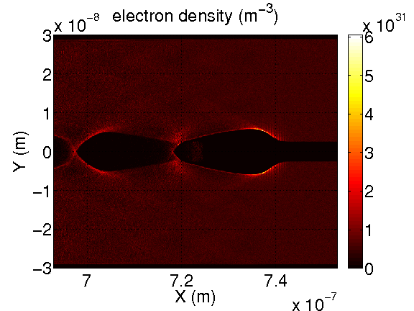
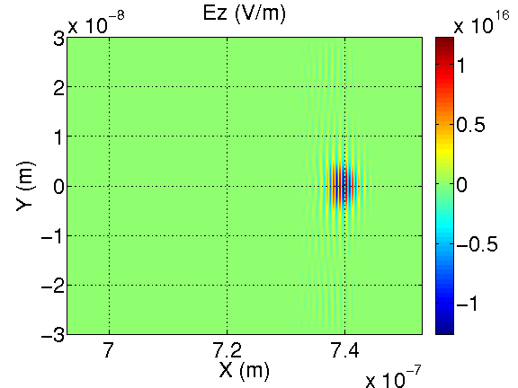
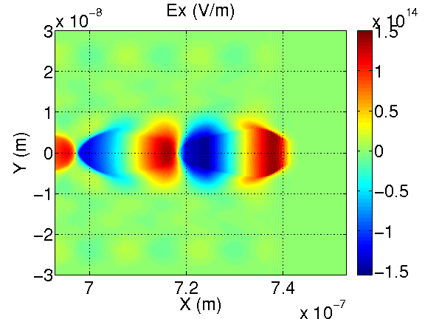
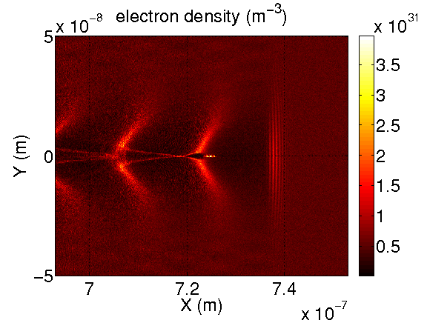
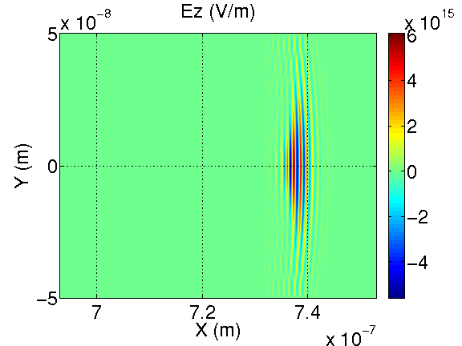
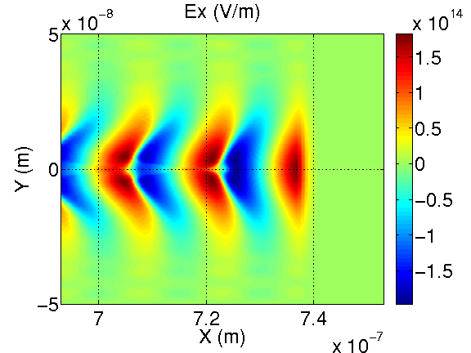
Wakefield comparison between the cases of a tube and a uniform density
tube case
uniform density case
X. M. Zhang, Tajima,…Mourou*,… (2016)

Slide 32



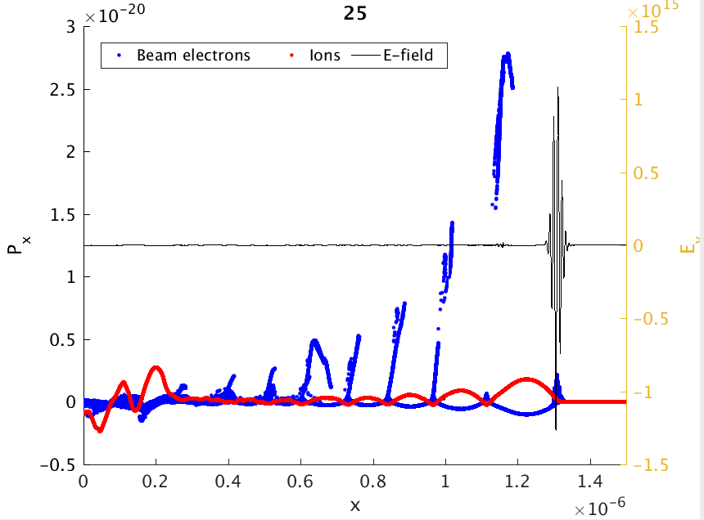
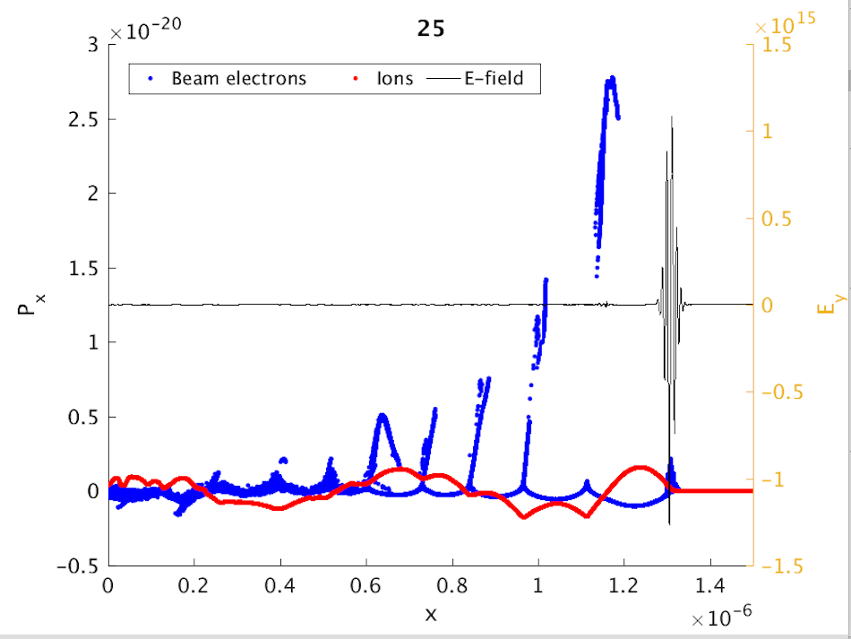
With and without optical phonon branch
Model of optical phonon branch: T. Tajima and S. Ushioda, PR B (1978)
→ nanoplasmonics in X-ray regime
Without lattice force (i.e. plasma)
(when ω_{TO} is much smaller than
ω_{pe} , there is no noticeable
difference from the below where
ω_{TO} = 0)
With lattice force (optical
phonon branch present)
S. Hakimi, et al. (2017)

Slide 33
Wakefield on a chip toward TeV over cm (beam-driven)
Y. Shin (2014)

Slide 34
Conclusions
Robust heightened energy state of plasma, Higgs’ state: Wakefields
In fusion plasma: FRC (Field Reverse Configuration), a Higgs’ state (or Landau-Ginzburg excited stable state)
Wakefields: Nature’s natural and ubiquitous creation: jets from Blackhole (AGN) driven by MRI instability of the accretion disk, NS-NS collisions
Gamma rays bursts (TeV), flares, Cosmic rays (ZeV): simultaneous observations
(sometimes with GW → Barish**’s LIGO observation of GW)
Toilet Science: efficient ion acceleration for transmutation
A new direction of ultrahigh intensity: zeptosecond lasers
EW 10keV X-rays laser from 1PW optical laser
Single-cycled X-ray laser pulse (relativistic compression)
X-ray LWFA in crystal: accelerating gradient (from GeV/cm) →TeV/cm
Nanoengineering: s.a. nanoholes, arrays, focus nano-optics for nano-accelerator
Start of zeptoscience: ELI-NP zeptoproject (collaboration)---
laser tools fit for nuclear phys. (←→attoseconds for atoms)
Scale revolution: eV→keV; PW→EW; as→zs; μm→nm; GeV/cm→TeV/cm;
100m→cm; μ-beam→nanobeam; 10¹⁸ /cc → 10²⁴/cc
→societal impact (medical, Toilet Science,…)
Laser acceleration: stimulated high field science laser technologies (CPA*, RC, CAN, TFC, …)

Slide 35
Thank you!
You taught me.
You nurtured me.
兼六の
十月桜
吾を迎ふ
感謝と誓ひ
砂利踏みしめたり
（11/11/2018,俊樹）

