Slide 1
Summary of MF Plasma
Xuru Duan and Min Xu
on behalf of all contributors
2nd DPP- APCPP 12–17 Nov. 2018，Kanazawa, Japan

Slide 2
Outline
Contributions to MF
Major Progresses
Major progresses of machines
ELM control and RMP
MHD and EP physics
Fueling and current drive
Transport and confinement
PMI
ITER and DEMO
Future Challenges and Summary

Slide 3
General Information for MF
Plenary ( 5)
EV (1- Chinese National Fusion program)
I (46)
O(25)
P(50)
Total ：126，Largest contribution in 2st DPP-AAPPS

Slide 4
Topics
Major progresses for machines
Donne, Weisberg, Felix, Tanaka, Oyama, Yang, Martin
ELM control and RMP
Liang, Kirk, Nazikian, Orain, Jang, In, Lee, Kwon, Ding, Wang, Fredrickson
MHD and EP physics
Chen, Li, D.H. Park, Mutia, Pucella, Raj, D.Chen, H.Park, Liu, Y.Li, Baruzzo, Shi, Zuin, Cai, Yu, Cordaro
Fueling and current drive
Ding, Yamato, Ohtani, Idei, Hanad, Baek, Xu
Transport and confinement
Zhong, Yamada, Citrin, Lee, Qi, Frigione, Fan, Marin, Nunami, Ren, Wu, Wang, Ichiguchi
PMI
F. Ding, R. Ding, Zou, Neu
ITER and DEMO
Loarte,Tony, Maviglia, Reinhart, Miyamae, Kikuchi, Porte, Zheng

Slide 5
Significant efforts have been focus on physics understanding.
Highlight
MHD and Energetic particle remains the hot topic (>25 talks)
Nonlinear processes have been deeply addressed.
More studies in support to ITER and DEMO-relevant physics
Critical issues emphasized: ELM control, disruption mitigation
Improvement of fueling efficiency and current drive
Advanced understanding of RMP-related physics
Multi-scale interaction and high-k turbulence in TC topic

Slide 6
Outline
Contributions to MF
Major Progresses
Major progresses for machines
ELM control and RMP
MHD and EP physics
Fueling and current drive
Transport and confinement
PMI
ITER and DEMO
Future Challenges and Summary

Slide 7
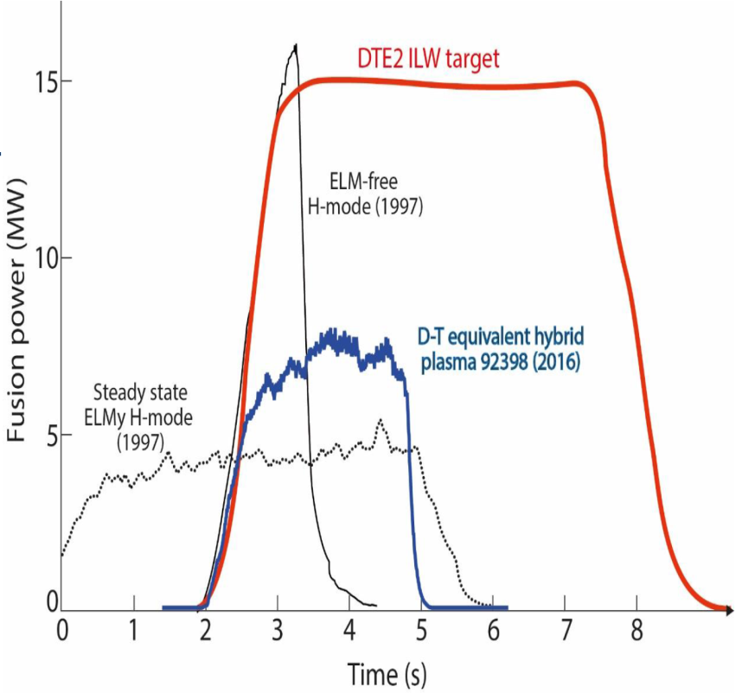
Major progresses for machines
JET – DT Operation
JET
JET’S HIGHLIGHTS
The only device currently capable of using deuterium and tritium fuel
First tokamak to achieve controlled deuterium-tritium fusion power (1991)
World record of
16 megawatts of fusion power (1997). This proved that large amounts of power can be produced from fusion
Projection for 2020
Results can be scaled up to ITER and power plants.
[P12 Antonius Donne]

Slide 8
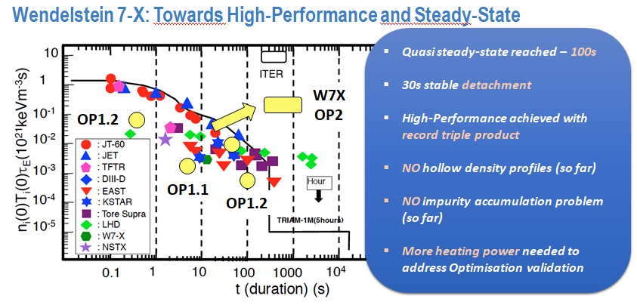
Major progresses for machines
W7-X
[MF-I34 Warmer Felix]

Slide 9
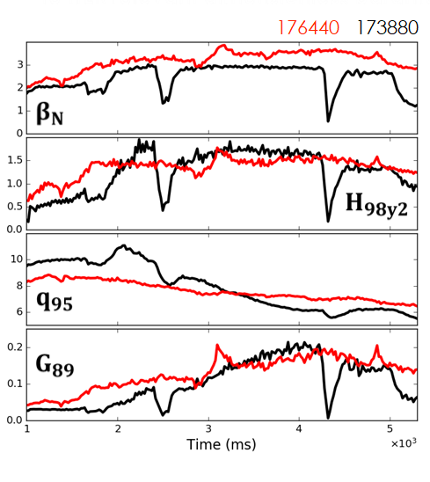
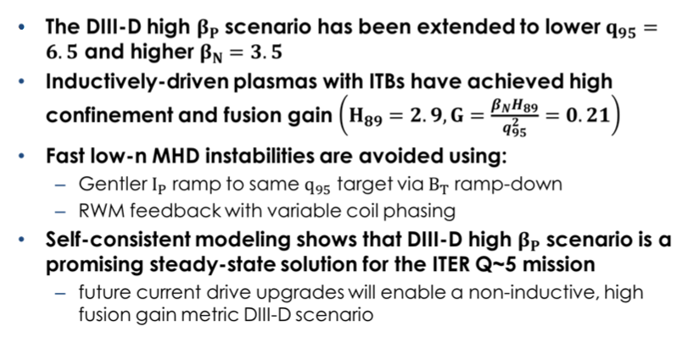
Major progresses for machines
DIII-D
Extension of the non-inductive high beta poloidal regime to ITER relevant dimensionless parameters on DIII-D
[MF-I24 David Weisberg]

Slide 10
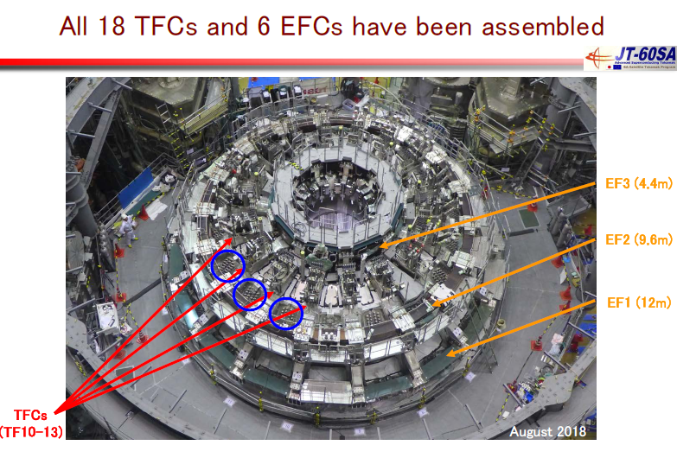
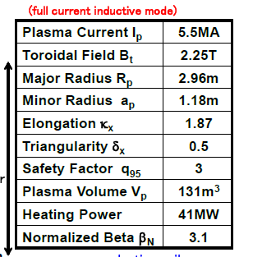
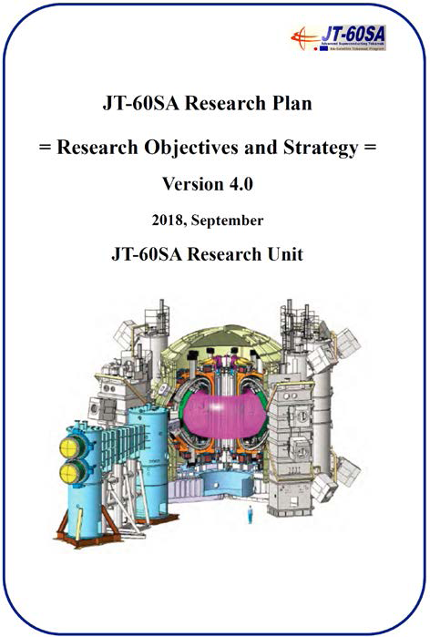
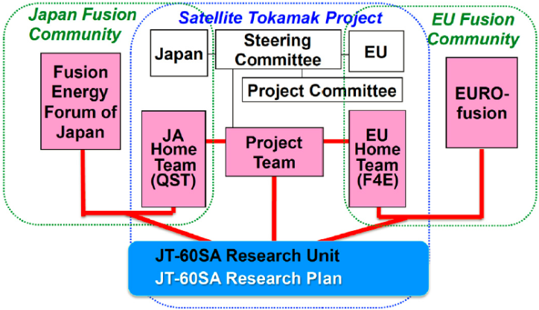
JT-60SA
http://www.jt60sa.org/pdfs/JT-60SA_Res_Plan.pdf
JA and EU fusion community members join “JT-60SA Research Unit” to study key physics and engineering issues of ITER and DEMO.
[P29,Naoyuki Oyama]

Slide 11
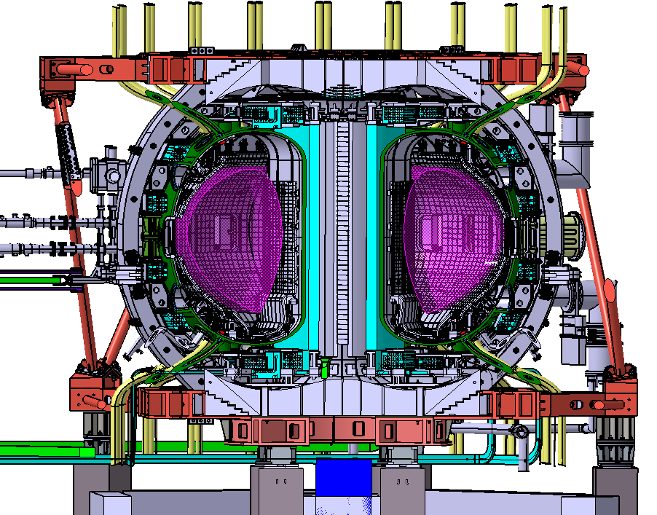
HL-2M under Construction
Mission: to support ITER, CFETR and next step devices, addressing critical physics and technology issues: burning plasma physics, divertor physics, high heat flux components
Main parameters
Plasma current I_{p} = 2.5 (3) MA
Major radius R = 1.78 m
Minor radius a = 0.65 m
Aspect ratio R/a = 2.8
Elongation κ = 1.8-2
Triangularity δ > 0.5
Toroidal field B_{T} = 2.2 (3) T
Flux swing ΔΦ= 14Vs
Heating power 25 MW
Features:
  Demountable magnetic coils;
  Small aspect radio;
  Flexible configuration;
  Advanced divertor.
[MF-I18 Qingwei Yang]

Slide 12
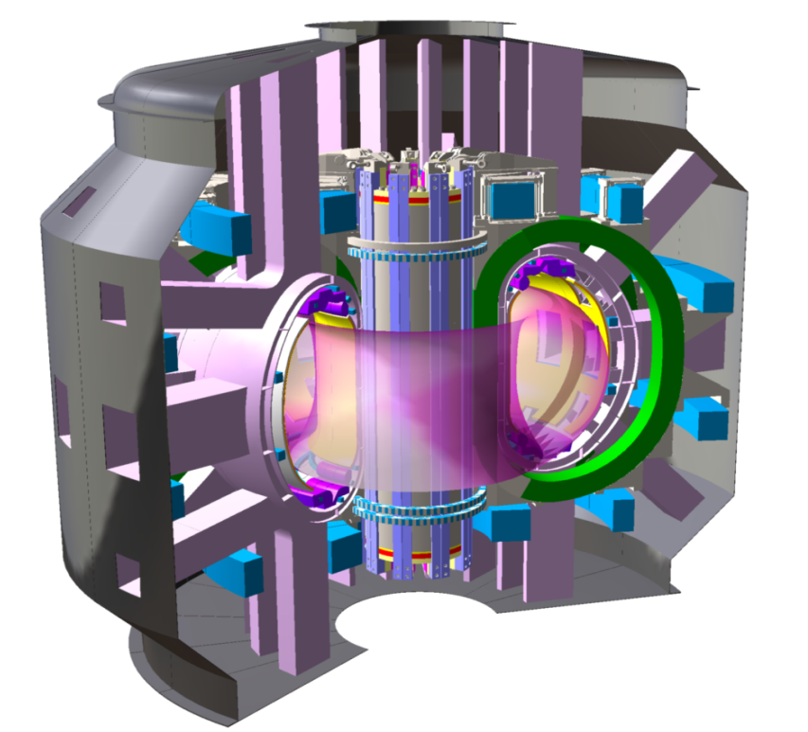
Divertor Tokamak Test facility: 5.5 MA, 6 T
Its main scientific goal: investigate energy and particle exhaust systems to withstand the loads expected in fusion power plant
Budget approved
Final design started
First call for tender: january 2019
Construction time: 7 years
Operation time: 25 years
R (m) | 2.10
a (m) | 0.65
A | 3.2
Vol (m³) | 28
q₉₅ | 3
I_{p} (MA) | 5.5
B_{T} (T) | 6
H₉₈ | 1
P_{aux} (MW) | 45
P_{sep}/R | 15
[MF-I4 Piero Martin]

Slide 13
Outline
Contributions to MF
Major Progresses
Major progresses for machines
ELM control and RMP
MHD and EP physics
Fueling and current drive
Transport and confinement
PMI
ITER and DEMO
Future Challenges and Summary

Slide 14
ELM mitigation and Suppression
Summary of existing methods
Radiative Dissipation
MONIER-GARBET P. , 2005, NF, 45, 1404
3D Magnetic Perturbations
Evans T.E., 2004, PRL 92 235003
Liang Y., 2007, PRL 98 265004
DIII-D, JET, MAST, KSTAR, AUG,
NSTX, EAST and HL-2A
Pellet ELM Pacing
Lang P.T., 2004 PPCF 46 L31–L39
AUG, JET, DIII-D and EAST
Vertical Kicks
Degeling A.W., 2003 PPCF 45 , 1637
TCV, AUG, JET and NSTX
SMBI
Xiao W.W. 2012, NF 52 114027
HL-2A, KSTAR and EAST
ECRH / ECCD
Rossel J.X., 2012 NF 52 032004
TCV, and AUG
LHW
Liang Y., 2013 PRL 110 235002
EAST, and HL-2A
Impurity injection
Hu J.S., 2015 PRL 110 235002
EAST, HL-2A and NSTX
[P5, Yunfeng Liang]

Slide 15
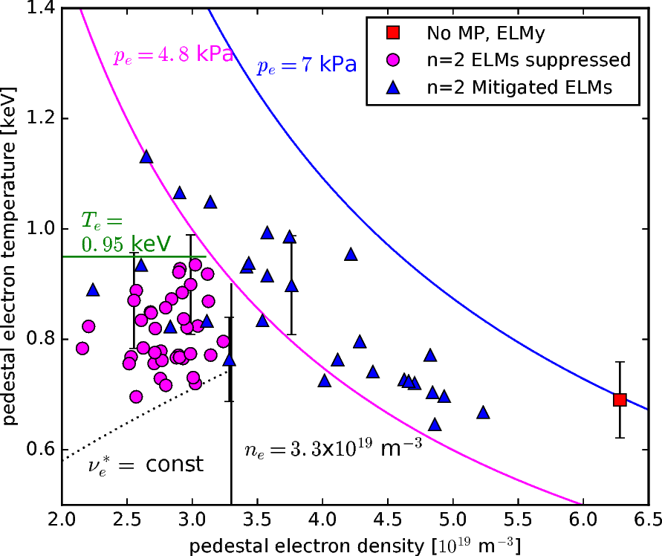
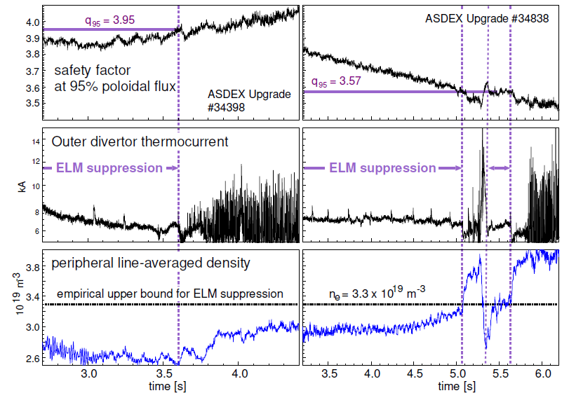
ELM Physics and Control
1. Safety factor in window:
q95 = 3.57 .. 3.95
Mitigated ELMs decorate a pedestal pressure limit
- ELM suppression occurs at lower pedestal pressure
→ Confinement improvement requires increased pedestal stability
4. No rotation threshold –
ELM suppression found also if
ω_{e,⊥} ≠ 0 at pedestal top
ω_{ExB} = 0 at the pedestal top
→ ELM suppression may be due to a resistive response, if kinetic effects destroy shielding of magnetic perturbation
[MF-I9 Andrew Kirk]

Slide 16
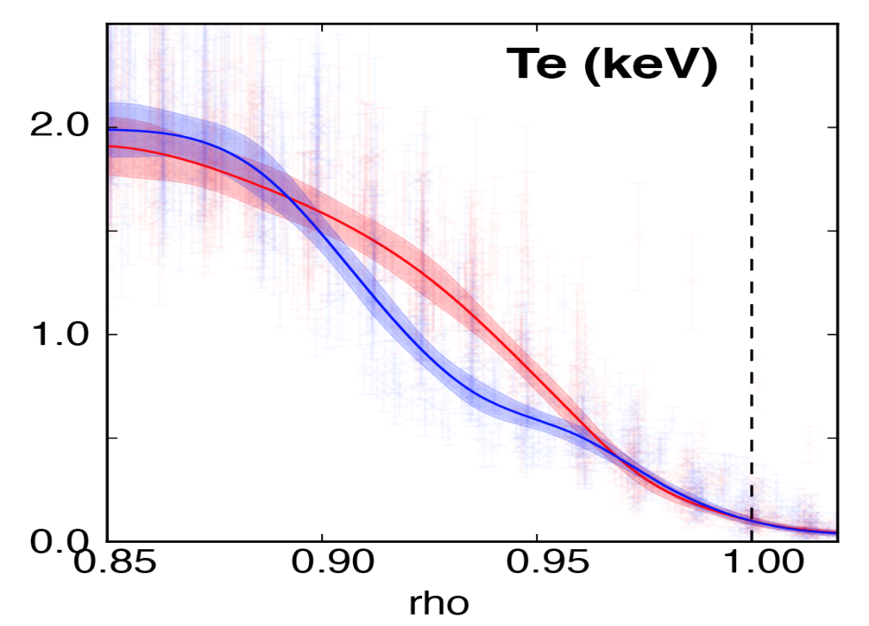
Staircase pedestal forms enhanced confinement and weak grassy-ELMs in DIII-D high beta poloidal plasmas
RMP
[MF-I37 Raffi Nazikian]
Natural weak ELMs, compatible with wide operating window
Grassy ELM associated with low-n kink peeling boundary
Scaling of grassy ELM needed for ITER and future reactor physics design

Slide 17
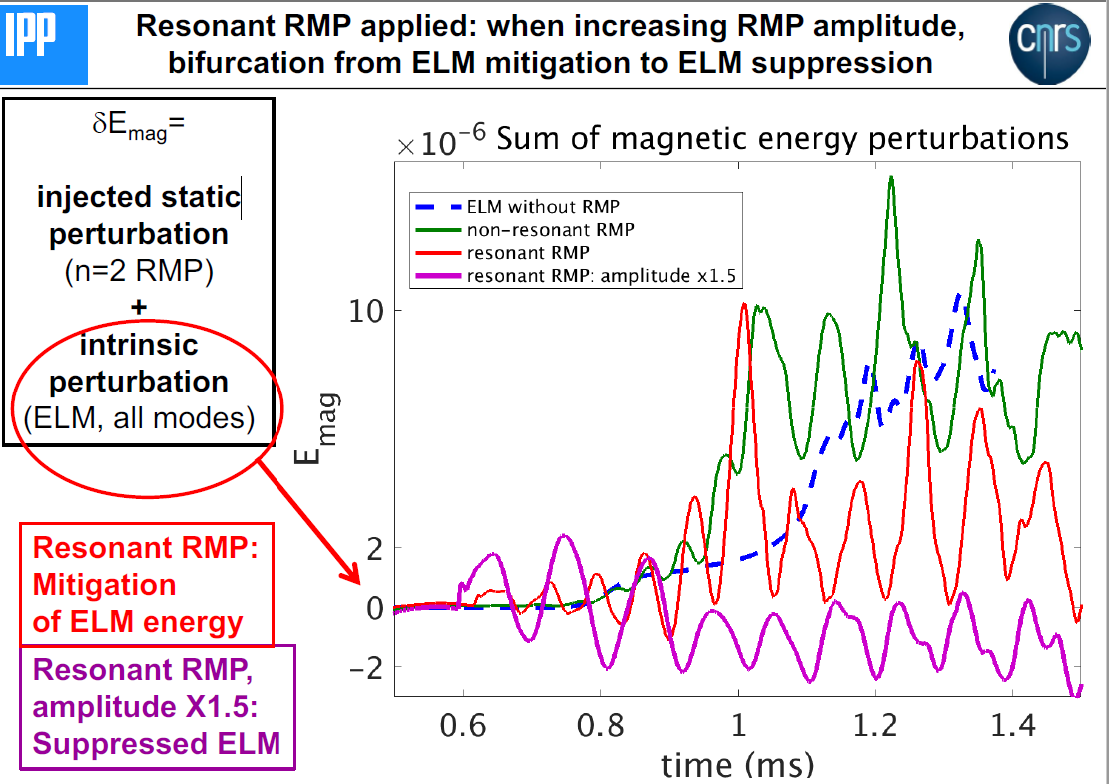
ELM Physics and Control
ELM mitigation/suppression:
→ NOT only due reduction of pressure gradient
→ due to toroidal mode coupling ELM-RMP.
[MF-I10 Francois Orain]

Slide 18
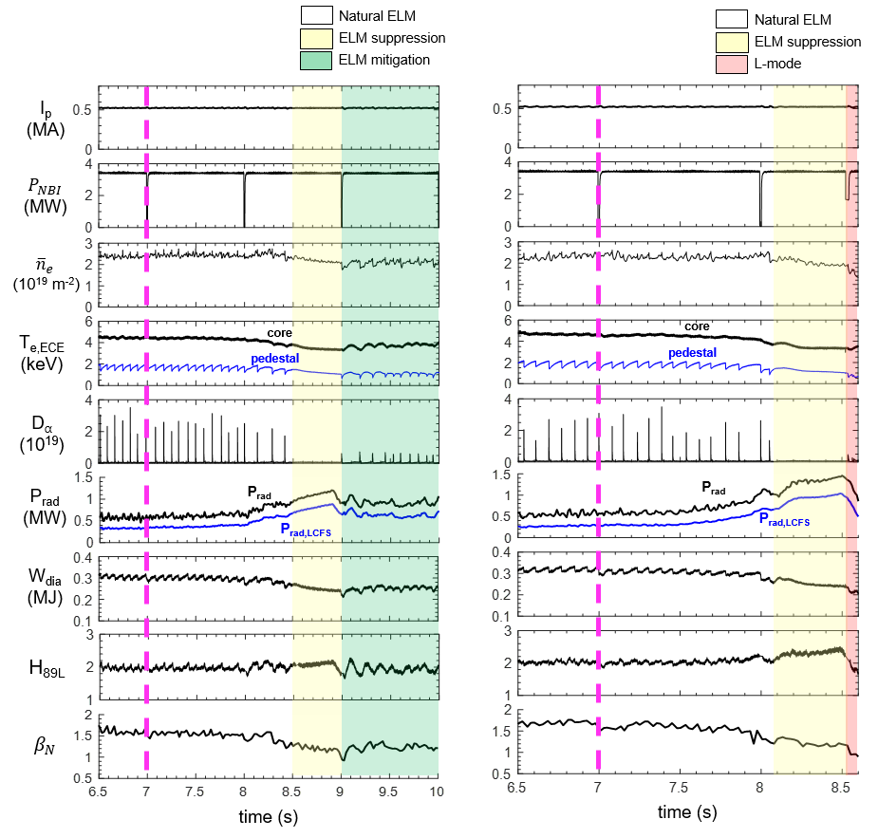
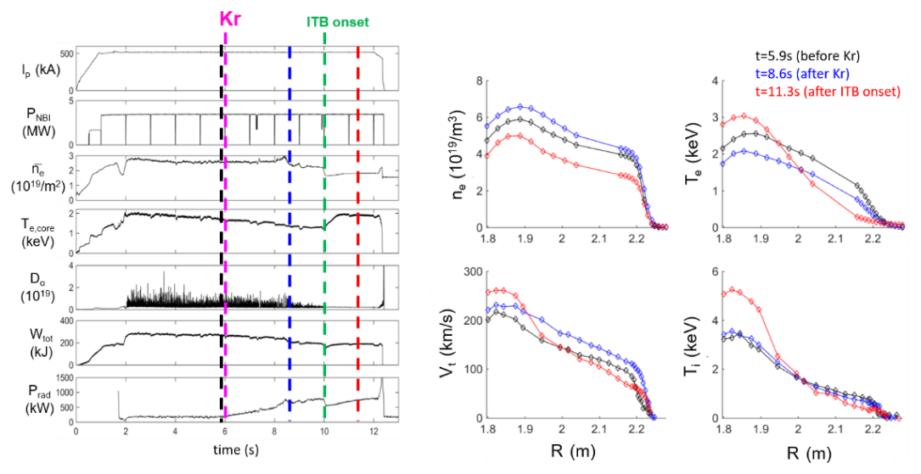
ELM Physics and Control
Krypton-induced ELM Suppression and Internal Transport Barrier in KSTAR Plasmas
(1) ELM Mitigation and Suppression by Kr Seeding
(2) Internal Transport Barrier Formation by Kr Seeding
(a) Medium Kr level
(b) High Kr level
ITB
ITB
ITB
<Summary>
By krypton (Kr) impurity seeding in KSTAR divertor,
ELM mitigated and ELM suppressed H-modes were achieved.
Internal transport barrier formation was observed in both ion and electron energy channels.
[MF-I11 Juhyeok Jang]

Slide 19
ELM Physics and Control
Several attractive ELM control methods have been developed for next-generation tokamaks, e.g. ITER.
Further investigations of ELM suppression/mitigation in more ITER relevant regimes (high δ, low ν*, …) are needed.
Further optimization of ELM control to avoid degradation of plasma performance (W_{p}, fast particle, rotation……) is still a great challenge!
Integration of various ELM control methods into the ITER relevant plasma scenario development is important for future fusion reactor.
[P5, Yunfeng Liang]

Slide 20
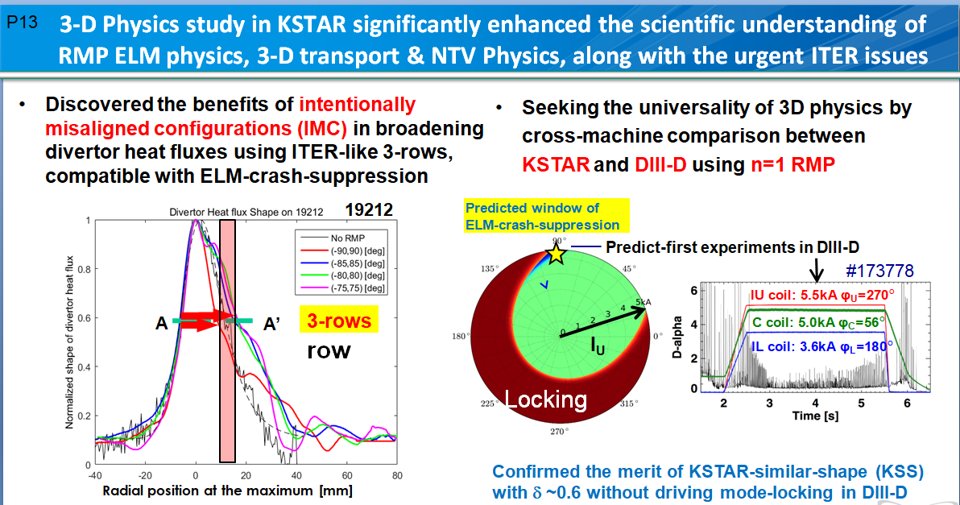
RMP
[P13 Yongkyoon In]

Slide 21
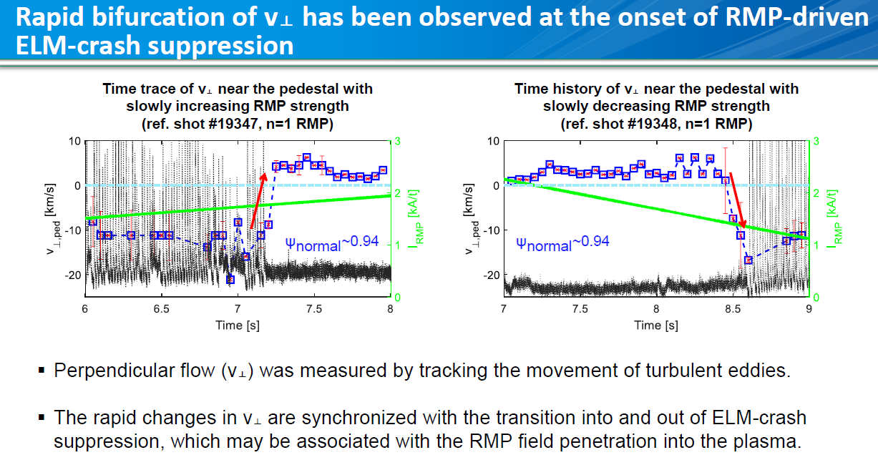
RMP
[MF-I38 Jaehyun Lee]

Slide 22
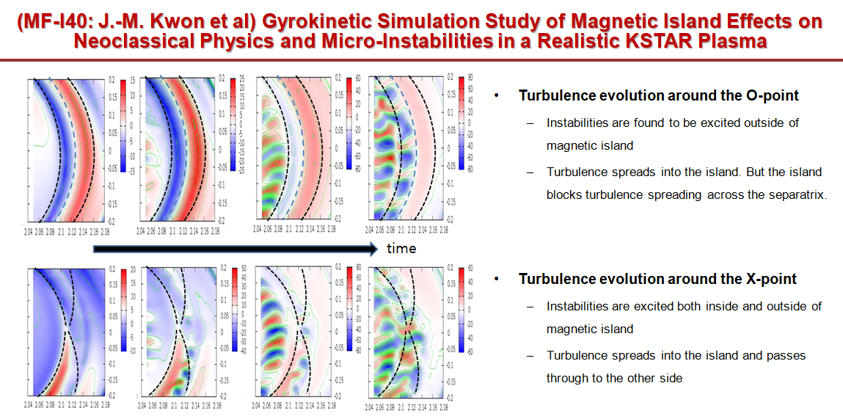
RMP
[MF-I40 Jae-Min Kwon]
Notes:
Different turbulence behaviors around O- and X-point

Slide 23
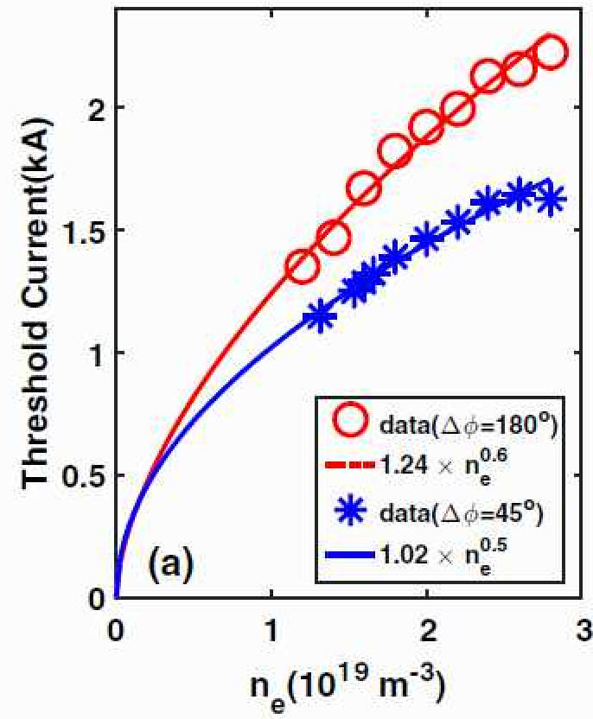
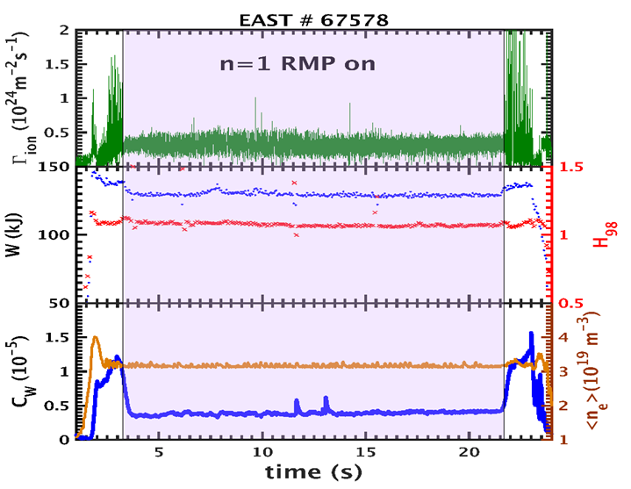
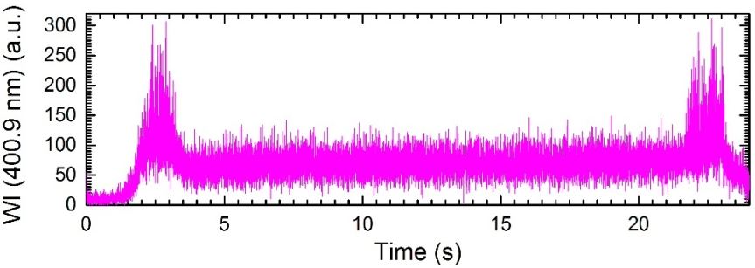
RMP
ELM suppression using RMP in long pulse plasma
Contradicted to the observations, previous theory predicted a weak density dependence, with the assumption that the energy confinement is in the Neo-Alcator regime.
The confinement lies in Ohmic SOC regime in EAST,
W source at divertor
[MF-I42 Fang Ding]
[MF-O5 HuiHui Wang]

Slide 24
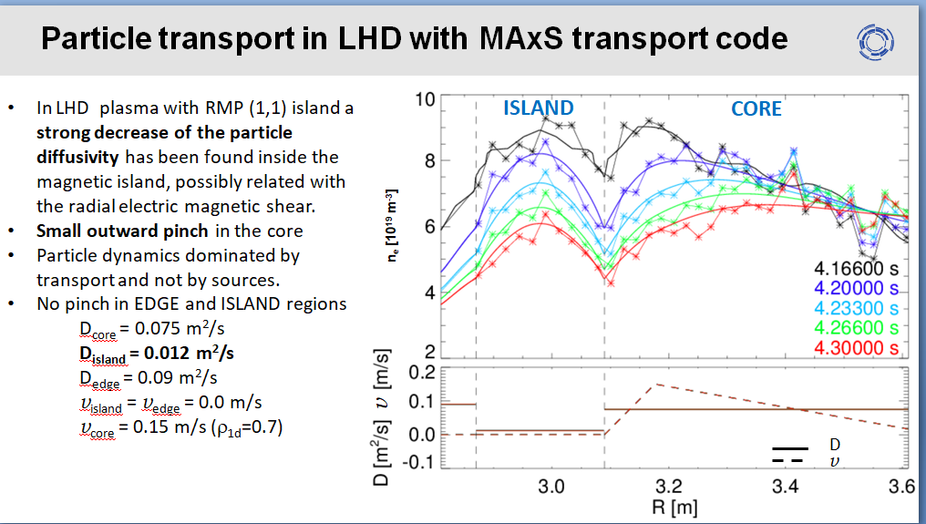
RMP
[Eric Fredrickson]

Slide 25
Outline
Contributions to MF
Major Progresses
Major progresses for machines
ELM control and RMP
MHD and EP physics
Fueling and current drive
Transport and confinement
PMI
ITER and DEMO
Future Challenges and Summary

Slide 26
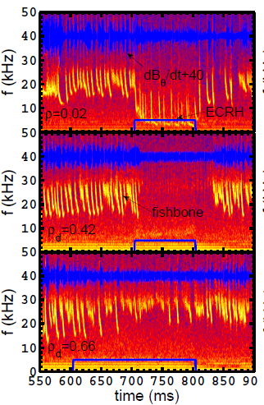
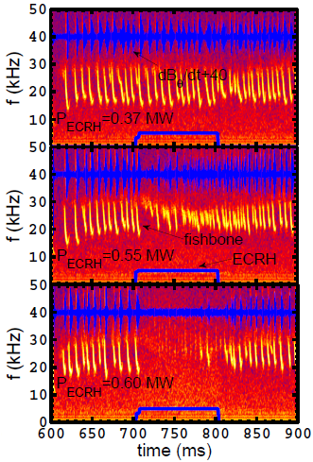
MHD and EP Physics
Ion fishbone suppressed by ECRH
[MF-I15 Wei Chen]
The mode stability depends not only on the injected power but also on the radial deposition location of ECRH, and the instability can be completely suppressed when the injected ECRH power exceeds certain threshold.

Slide 27
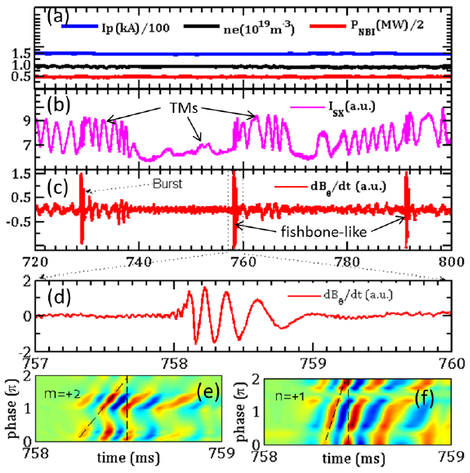
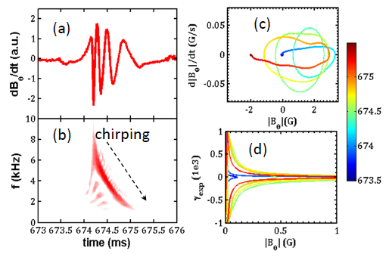
MHD and EP Physics
Resonant interactions between energetic ions and the unstable m/n=2/1 TM are observed for the first time on HL-2A.
Typical discharge parameters with TMs and fishbone-like activities during NBI heating on HL-2A.
[MF-I15 Wei Chen]

Slide 28
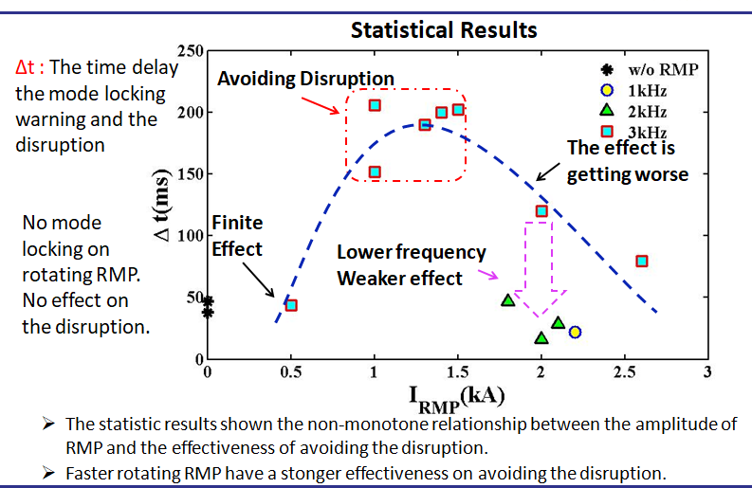
MHD and EP Physics
Active control of tearing mode by RMPs on J-TEXT
[MF-O6 Da Li]
Magnetic island structure effect on runaway electron confinement
[MFP-44 Dong-Ho Park]
To characterize energetic particle beams using stark broadening analysis of hydrogen lines
[MF-O19 Meireni Mutia]

Slide 29
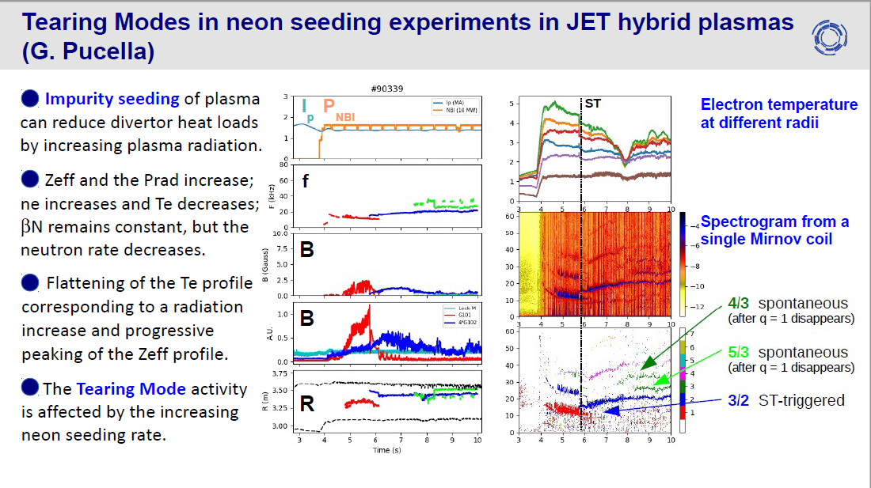
MHD and EP Physics
[MF-O13 Gianluca Pucella]
Direct experimental evidence of interaction between Drift-Tearing modes and the periodic gas puffs in the edge ADITYA/ADITYA-U plasmas.
[MF-I45 Harshita Raj]
Disruption mitigation with high-pressure argon gas injection
on EAST tokamak
[MF-O16 Dalong Chen]

Slide 30
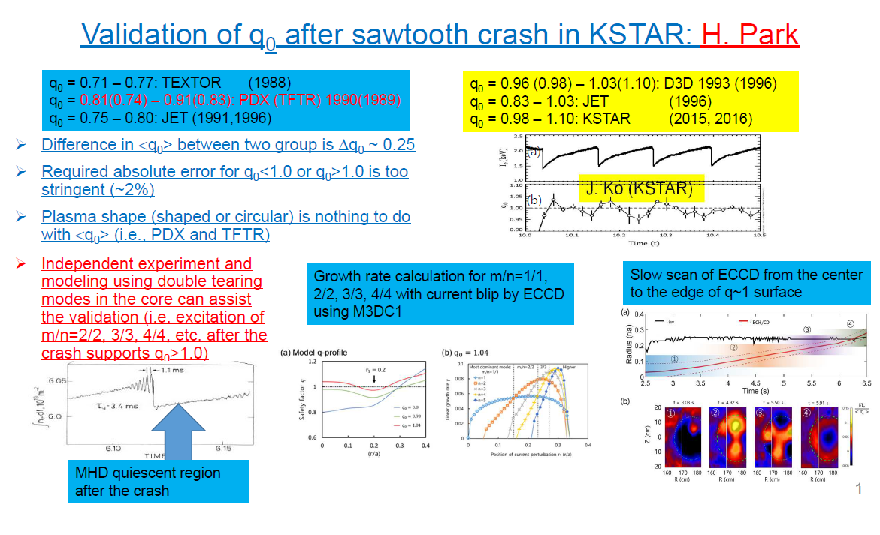
MHD and EP Physics
[MF-I25 Hyeon K Park]
Notes:
q0 is larger than 1 after the sawtooth crash

Slide 31
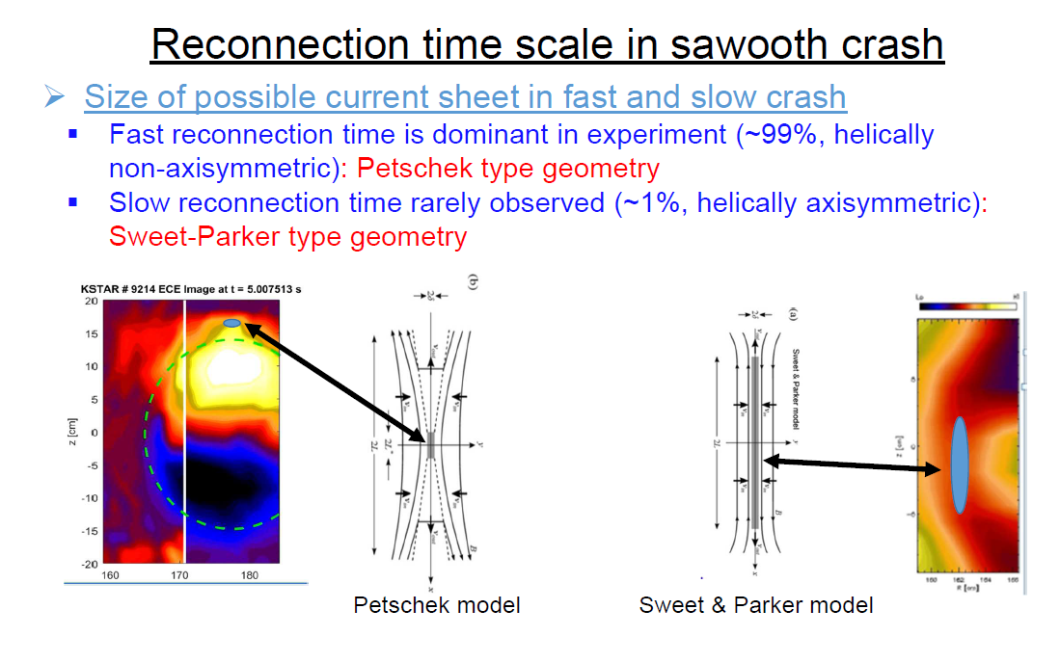
MHD and EP Physics
[MF-I25 Hyeon K Park]

Slide 32
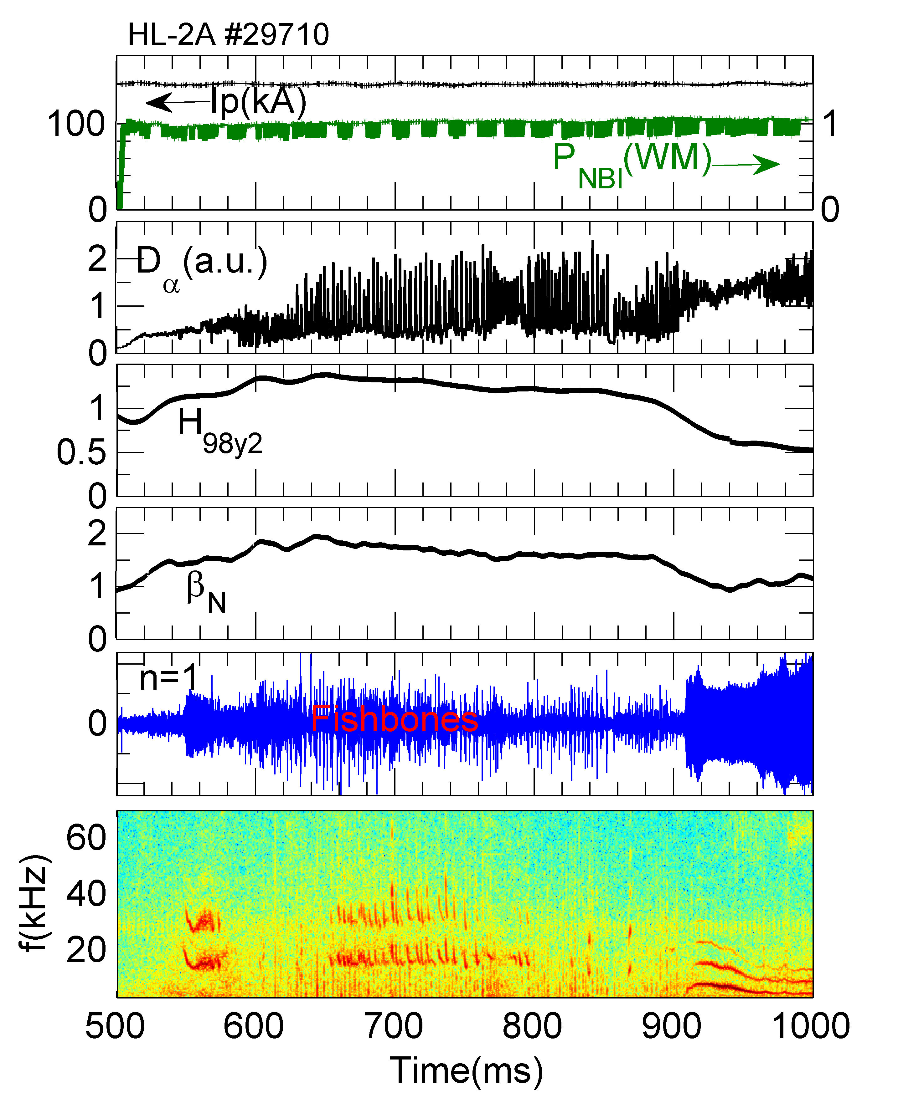
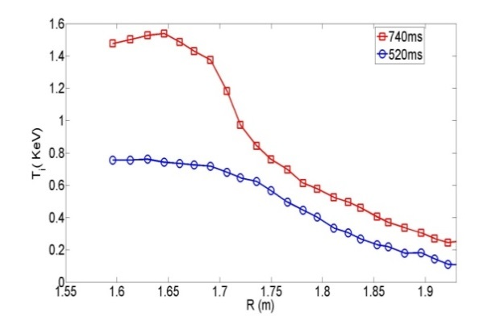
MHD and EP Physics
Internal transport barrier (ITB) in H-mode plasma
Fishbone → fast ion redistribution→ change of q shear → affect transport → ITB formation
ITB
ELMy
HL-2A # 29710
(1/1) fishbone plays an important role in the formation and sustainment of ITB at low central shear;
Formation of ITB in H mode plasma
Turbulence suppressed during ITB sustainment
[MF-I13 Yi Liu]

Slide 33
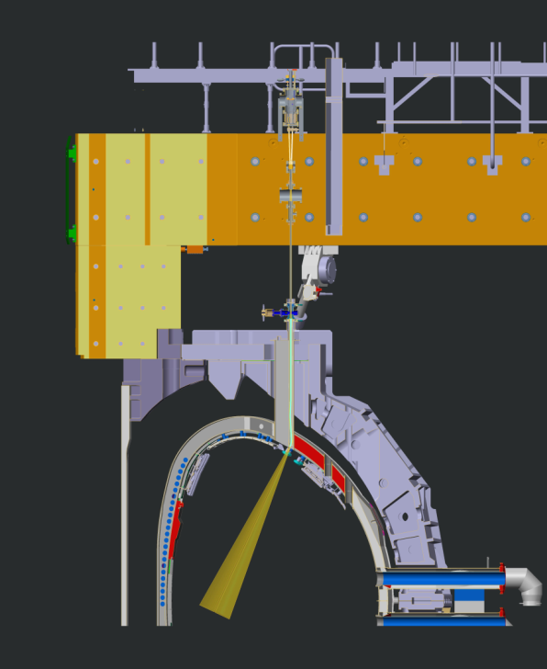
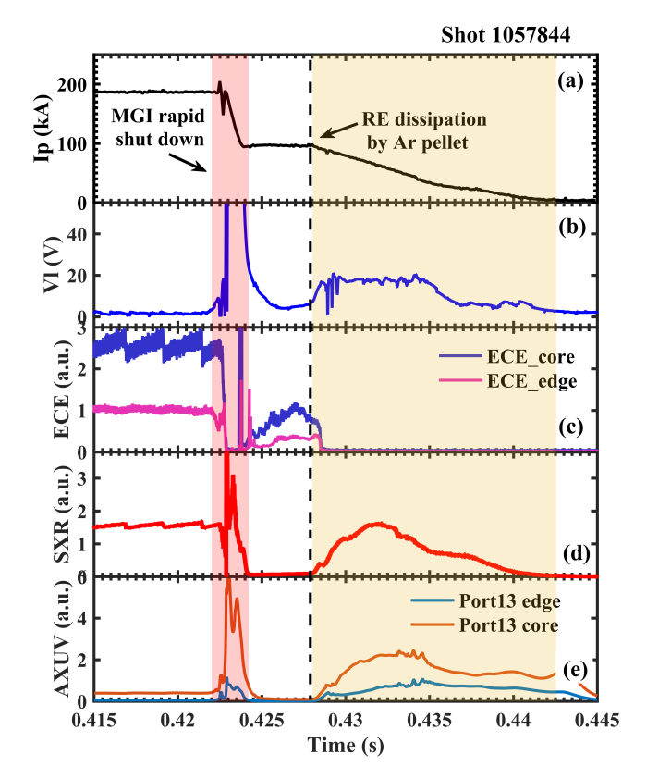
The first experimental result of shattered pellet injection system on J-TEXT tokamak
MHD and EP Physics
SPI installation on JET
SPI is located on top of machine in place of DMV1
SPI presently under commissioning
A Shattered Pellet Injection model has been included in the 3D non linear MHD code JOREK in order to predict SPI effectiveness in heat load mitigation for ITER.
[MFP-14 You Li]
[MF-I28 Matteo Baruzzo]

Slide 34
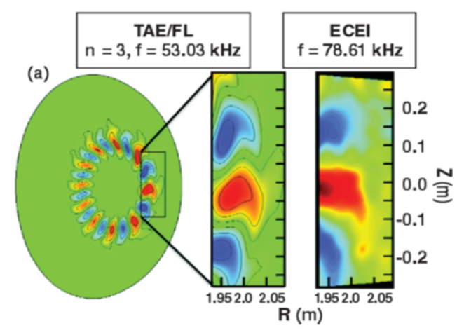
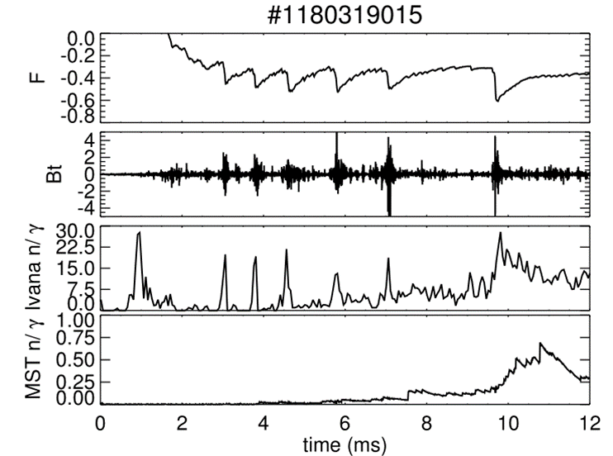


MHD and EP Physics
Current technology (mini-lens) has been widely applied on a number of major tokamaks and has provided important contributions on instabilities.
Neutron-gamma detected during magnetic reconnection events with high temporal resolution
Major Improvement from System on Chip Advancements
Significant Noise Temperature Reduction
Shrink the System Size
Individual Module
Well Shielded from Environment
Cost Reduction
Magnetic reconnection events
[MF-O20 Jo-Han Yu]
[MFP-24 Luigi Cordaro]

Slide 35
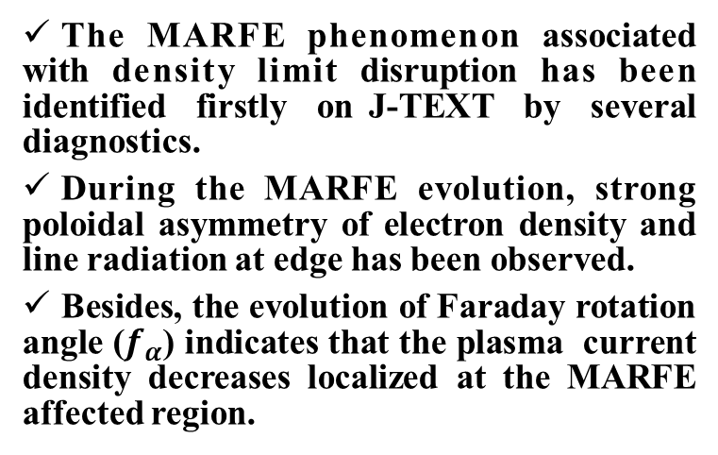
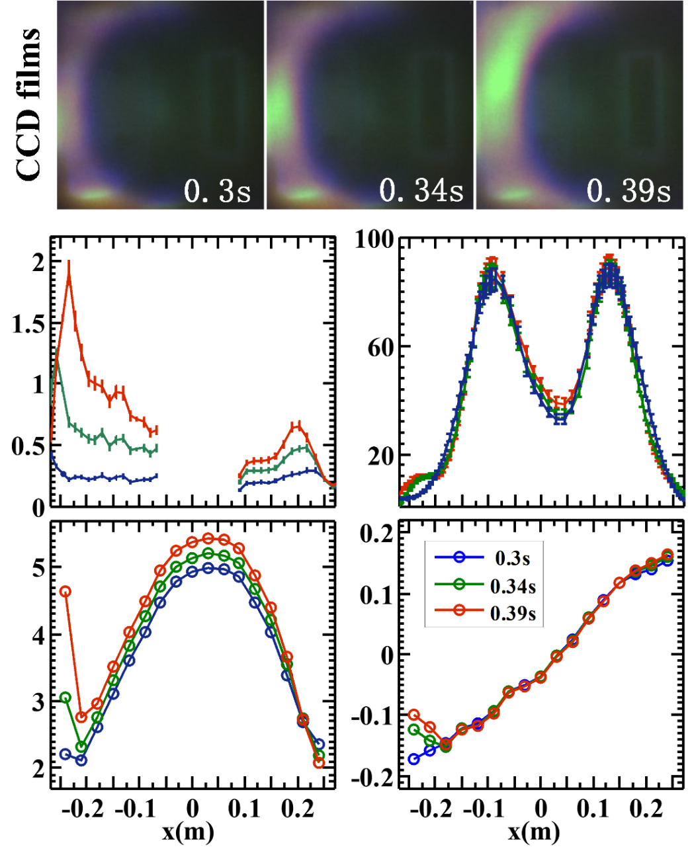

MHD and EP Physics
CIII emission
Radiation
power
Features of MARFE (locally at HFS edge):
Strong CIII emission
Large radiation loss
Bright blob on CCD films
High plasma density
Low plasma current
Line-aver.
density
[MFP-16 Peng Shi]

Slide 36
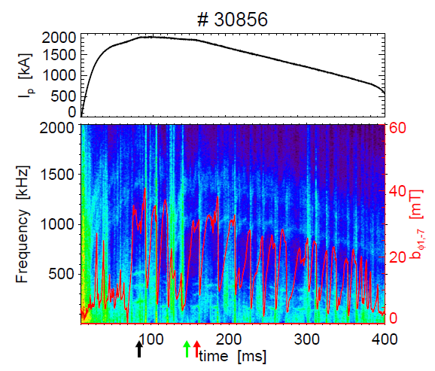
MHD and EP Physics
Alfvèn large-scale (n=0, ω=k//v_{A}) eigenmodes are found to be almost ubiquitous in the ohmic RFX-mod plasmas.
Influence of toroidal rotation on magnetic islands
The toroidal rotation is dominant, and overcomes the destabilizing effect of polarization current, namely the onset threshold of NTMs increases.
[MF-O8 Mmatteo Zuin]
[MF-I27 HuiShan Cai]

Slide 37
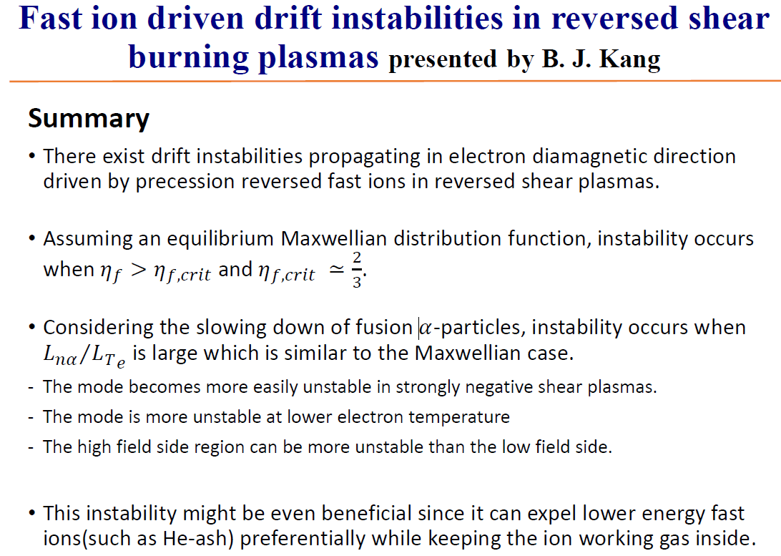
MHD and EP Physics
[MF-O7 ByungJun Kang]

Slide 38
Outline
Contributions to MF
Major Progresses
Major progresses for machines
ELM control and RMP
MHD and EP physics
Fueling and current drive
Transport and confinement
PMI
ITER and DEMO
Future Challenges and Summary

Slide 39
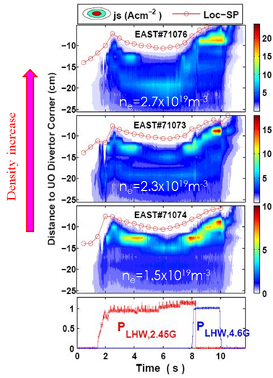
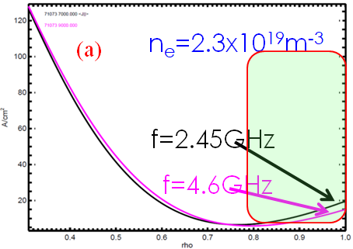
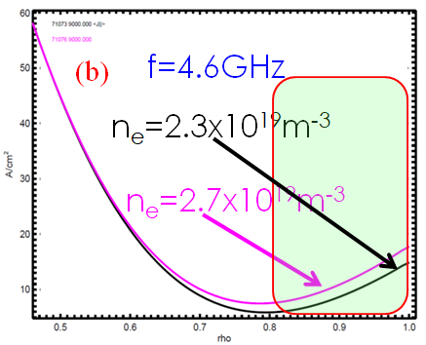
Fueling and current drive
□ Lower recycling and higher LH frequency are preferred to improve LHCD capability at high density.
□ The correlation between the onset of parametric instability of LH waves and modification in edge plasma current profile is observed, offering one possible method to control plasma current profile in edge region.
[MF-O9 Bojiang Ding]

Slide 40
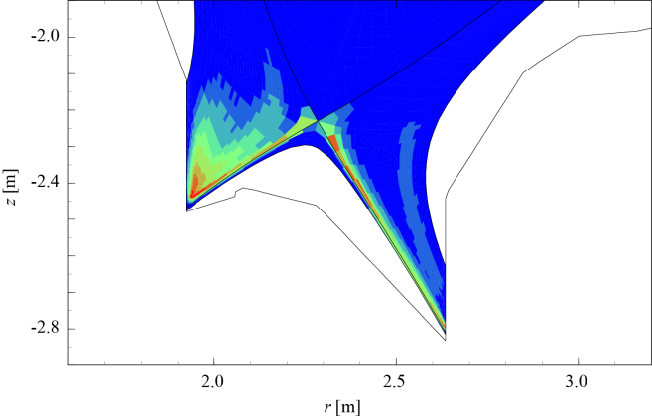
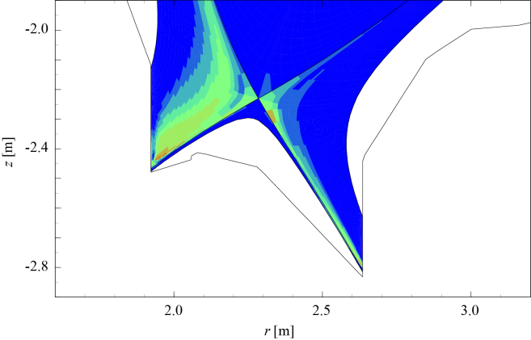
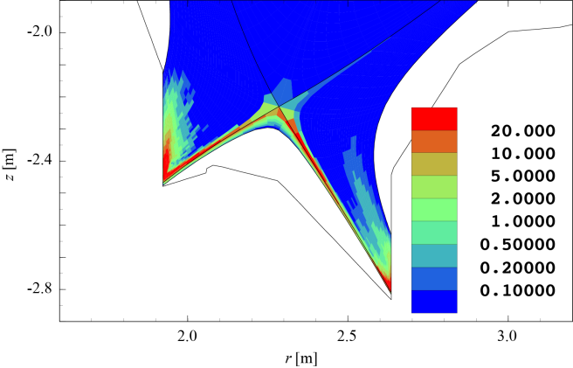
Fueling and current drive
-> Applied to the predictive simulation of the Ne+Ar mixed-seeding in JT-60SA operation
1st step: Basic understandings of multi-impurity seeding
[MF-O23 Shohei Yamato]
2nd step: Exploration of gas puff & impurity seeding rate which satisfies
the target parameters of the JT-60SA steady-state high-β operation
[MW/m⁻³]
Ar radiation
3.5 MW
Ne radiation
2.3 MW
C radiation
7.0 MW
The impact of the particle source profile is twice as much as that of the collisionality.
The impact of ∇T_{i}/T_{i} in the edge region is similar to the particle source profile.
[MF-O25 Yoshiaki Ohtani]
Scaling B

Slide 41
Fueling and current drive
The longest duration of plasma maintenance was 1 h 55 min, during which the model-predicted particle balance was partially confirmed.
The recycling ratio is beyond unity. It is the main reason to be difficult to control density at the targeted value.
[MF-I21 Kazuaki Hanada]

Slide 42
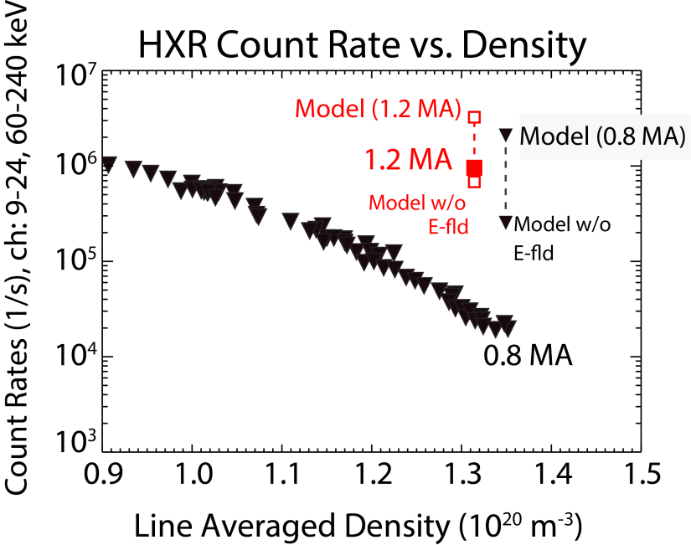
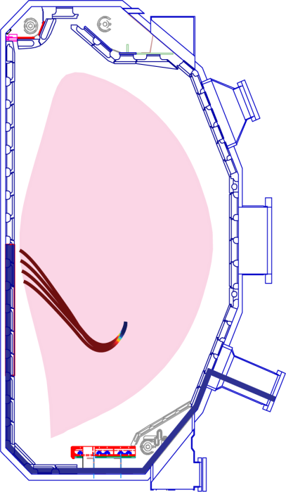
[MFI-36 S. G. Baek]: Efficient lower hybrid current drive is demonstrated at high density in a diverted plasma with a proper management of the SOL plasma.
Fueling and current drive
At high density, current drive efficiency (η=n_{e}I_{p}R₀ / P_{LH} ) deteriorates anomalously.
  “LH density limit problem” observed across the tokamaks^{1,2}
On C-Mod, parasitic wave interactions with the SOL plasma is suppressed in a high current plasma (low Greenwald fraction plasma) with a narrow SOL width and a low level of SOL turbulence.
A recovery of η ≈ 2.5 (10¹⁹ A W⁻¹ m⁻²) and improved hard X-ray production rates are observed ³, consistent with modelling.
High-field-side launch⁴ in a double null configuration may provide an optimum SOL condition in a reactor, in addition to improved core wave physics and launcher survivability⁵.
  Experiment is planned on the DIII-D tokamak in late 2020⁴.

Slide 43
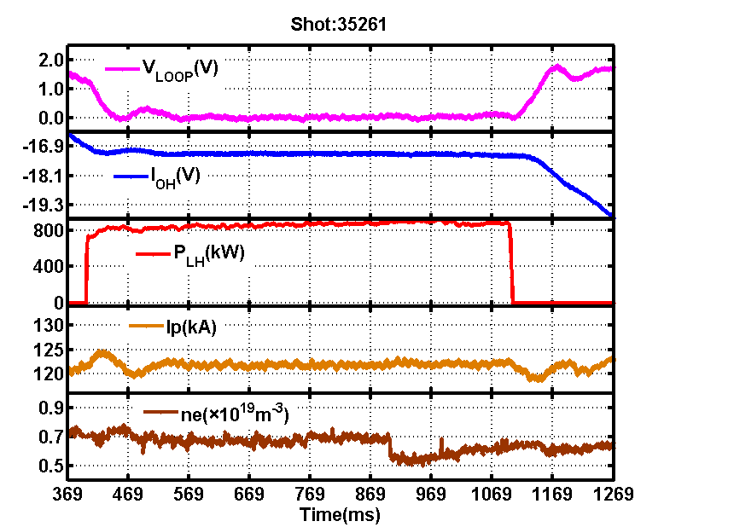

Fueling and current drive
LHCD with Passive-Active Multijunction (PAM) antenna
Recent results: full non-inductive current, V_{Loop} ~ 0 with PAM antenna
High coupling efficiency in H-mode
Passive-Active Multijunction (PAM)
Local gas injection valves at three poloidal locations
Langmuir probes for T_{e} and n_{e} at two radial locations
  1 MW LHCD (I_{P} = 120 kA, B_{T} = 1.3 T)
[MF-I3 Min Xu]

Slide 44
Outline
Contributions to MF
Major Progresses
Major progresses for machines
ELM control and RMP
MHD and EP physics
Fueling and current drive
Transport and confinement
PMI
ITER and DEMO
Future Challenges and Summary

Slide 45


Transport and confinement
Multi-scale interactions are extensively studied in HL-2A.
[P26 Wulyu Zhong]
Nonlinear interaction observed for the broadnband electromagnetic turbulence
The frequency entrainment and phase lock, two essential elements in synchronization, are demonstrated.
The enhancement of nonlinear interactions can facilitate the L-H transition and lower the H-mode power threshold.

Slide 46

Transport and confinement
The difference of stiffness and turbulence characteristics in H and D plasma are observed
[MF-O2 Kenji Tanaka]
H and D isotope effects are extensively studied in LHD. Better τ_{E} and degraded τ_{p} in D were found in ECRH plasma.

Slide 47

Transport and confinement
[MF-I5 Hiroshi Yamada]

Slide 48



Transport and confinement
J.Citrin (DIFFER, NL), C. Bourdelle, F J Casson F Felici, A. Ho, M. Marin, K L van de Plassche
QuaLiKiz: gyrokinetic quasilinear transport. Bourdelle PPCF 2016, Citrin PPCF 2017. www.qualikiz.com
[MF-I33 Jonathan Citrin]
F Casson IAEA 2018

Slide 49



Transport and confinement
Quasi-coherent modes (QCMs) were observed in ECH or ohmic L-mode plasmas in KSTAR, HL-2A and J-TEXT.
The measured turbulence transition from ITG to TEM consistent with the result from Tore-supra.
[MF-I26 Woochang Lee]
[P26 Wulyu Zhong]
Nonlinear spectrum shows background turbulence changes from TEM to ITG.
[MFP-39 Lei Qi]

Slide 50


Transport and confinement
New TOKAM3X-EIRENE package allows 3D global simulations including self-consistently turbulence and neutrals physics
The turbulent flux due to the drift leads to anomalous poloidal transport
Neon seeded discharges feature higher
peaking factors than those observed in
the usual un-seeded case. It is not due to a decrease in collisionality.
[MF-O3 Domenico Frigione]
[MF-O4 DongMei Fan]

Slide 51

Transport and confinement
Studied the effects of the global flow on the interchange modes with a strongly unstable sample equilibrium.
[MF-O15 Katsuji Ichiguchi]
Prediction of D core source with QuaLiKiz turbulence model agrees with measurements
[MFP-37 Michele Marin]
Comprehensive analyses for anomalous and neoclassical transport of multi-ion-species plasmas in helical systems are performed by gyrokinetic and drift-kinetic simulations.
[MFP-35 Masanori Nunami]

Slide 52

Transport and confinement
Before L-H transition
after intermittent phase
Further into H-mode
A multi-fluid model indicates that the stabilization of edge instability, ExB shear and SOL physics are key factors for the H-mode threshold power.
[MF-I6 Yang Ren]
First detailed measurements of high-k (electron-scale) turbulence across L-H transition in NSTX
Suppression of high-k turbulence at lower wavenumbers
[MF-I7 Xingquan Wu]
The quasi regular shear layers of the E×B staircase is generated through turbulence-driven zonal flow
[MF-O12 Wei Wang]

Slide 53
Outline
Contributions to MF
Major Progresses
Major progresses for machines
ELM control and RMP
MHD and EP physics
Fueling and current drive
Transport and confinement
PMI
ITER and DEMO
Future Challenges and Summary

Slide 54


PMI
Radiative divertor without confinement degradation with feedback control on J_{sat} or P_{rad}
[MF-O21 Guizhong Zuo]
Low H/(H+D) achieved by Silicon (~10%) and lithium (~3%) coating
Li coating is more effective than SiD₄ coating for hydrogen control
[MF-I42 Fang Ding]
WI photo flux (cm⁻²s⁻¹sr⁻¹)
0.6%C
1%C
Model with re-erosion
Model without re-erosion
[MF-I41 Rui Ding]
Good agreement between measured W gross erosion rate and the ERO modeling taking into account re-erosion processes

Slide 55



PMI
Excellent agreement of precision erosion
measurements with SDTrim calculations
(1-3 dim.) for Fe and W
Large set of erosion/deposition probes exposed in W7-X (retrieval just about to start)
Successful use of W-fibres (W_{f}) to reinforce
- W: increase of fracture toughness
- Cu: increase of high temperature
strength
Development of high performance
mock-ups for the DEMO divertor
(withstand 500 pulses @ 20 MW/m²)
angle dependent
sputter yield of Fe
from 2 keV D
W_{f}/Cu
[MF-I17 Rudolf Neu]

Slide 56
Outline
Contributions to MF
Major Progresses
Major progresses for machines
ELM control and RMP
MHD and EP physics
Fueling and current drive
Transport and confinement
PMI
ITER and DEMO
Future Challenges and Summary

Slide 57


ITER Research Plan
ITER
ITER Research Plan (IRP) within Staged Approach
Strategy to achieve Project goals: Q = 10 (300-500 s), Q = 5 (1000 s) & Q = 5 steady- state from First Plasma supported by systems in each phase of Staged Approach
IRP publicly available as ITR-18-003: https://www.iter.org/technical-reports
IRP informs fusion community on details of experimental plans to achieve Project’s goals to define the supporting R&D required to refine IRP
[MF-I1 Alberto LOARTE]

Slide 58

The revised European Fusion Roadmap
Short-term
Medium-term
Long-term
Research on present and planned facilities, analysis and modelling
ITER
First plasma
Full performance
Commence
construction
Fusion Power Plants
Consistent
concept
Electricity
production
DEMO
Material research facilities IFMIF/DONES
Stellarator as fusion plant?
Lower cost through concept improvements and innovations
Milestone
[P12 Antonius Donne]

Slide 59
ITER developments of relevance to DEMO design - examples
2020
pre-CDR Gate
2027
CDR Gate
2038
Decision to Construct
DEMO Schedule
2014-2020
Preconceptual Design
2020-2027
Concept Design
2027-2029
CDR
Consolid.
2029-2038
Engineering Design & Site Selection
2038-2040
EDR
Consol
2040-2051
Procurement & Construction
2051-2060
Commissioning & Operations
2014
2025
2029
2033
2035
2037
2039
2060
A
B
C
D
E
F
ITER Schedule
2025-26 First Plasma
2026-2028
2nd Assembly
2028-2030
Pre Fusion Operation 1
2030-2032
3rd Assembly
2032-2034
Pre Fusion Operation 2
2034-35
4th Assembly
2035-2040
High Power Operation
2025
2040
Operation with Low Heating
Low Power Operation
(Hydrogen & Helium)
High Power Operation
(Hydrogen & Helium)
High Power Operation
(Deuterium-Tritium)
Installation of: First Wall, Divertor, Neutral Beam Remote Handling, Pellet injector,
DMS hardware commissioning
Installation of: ICRH & NB,
ELM control system
First TBM modules
Tritium Plant
Tritium Plant Commissioning
A
Validated Assembly, Integrated Design,
Testing & Commissioning, SC magnets,
VV fabrication validation
B
Integrated diagnostics validation,
ECRH performance, Disruption characterisation, Divertor remote maintenance validation
C
H-mode transition threshold, Validation of ELM control & disruption mitigation,
NB & ICRH performance, Diagnostics validation,
Validation of TBM fabrication
D
Burn scenarios, Bootstrap fraction,
Full plasma control incl. helium and impurities ,
First wall heat loads,,
Exhaust at high power Tritium plant validation,
Full H&CD and fuelling validation
E
TBM Validation, Operational scenario refinement,
Q=10 (short pulse)
F
Long pulse) burning plasma

Slide 60


DEMO
Performance of HTS material REBCO is superior
and increasing fast
Industrial available REBCO can provide large temperature margin even at highest magnetic fields
REBCO performance has increased drastically in the last years
But REBCO is available
as thin tapes, only.
How to form high current cables from such tapes?
HTS CroCo fabricated with 8 m length!
[P12 Antonius Donne]

Slide 61

DEMO
EU-DEMO Wall loads specifications are different from ITER, due to different requirements :
Tritium breeding self sufficiency
Power conversion (High temperature → high efficiency)
Operate in high neutron environment (materials)
DEMO FW - breeding blanket
W (2mm)
Eurofer (3mm)
breeding zone
ITER FW designed for up to 4.7MW/m².
Present DEMO first wall (FW) capabilities ~1-1.5 MW/m².
Coolant He/H₂O
high press/temp
DEMO Plasma and geometry optimization:
Passive and active Vertical Stabilization optimization of single and double null configurations
Increase Plasma elongation → increase fusion power → reduce machine major radius
Identification and design of plasma-wall contact areas and discrete limiters protection strategy.
[MF-I20 Francesco Maviglia]

Slide 62



DEMO
Progress in European research towards efficient Plasma-Facing Components for ITER and DEMO
Research related to: EUROfusion Roadmap Mission 2: Heat Exhaust Systems
Baseline strategy: Conventional tungsten single null divertor
Risk mitigation strategy: Alternative divertor design + materials (incl. Liquid metals)
EUROfusion PFC research covers both strategies for ITER and DEMO.
Examples:
Laser, then plasma │ simultaneously │ plasma, then laser
Deuterium accumulates in He-implanted zone below the surface
Vapour shielding limits the temperature of LM surface
[MF-I19 Michael Reinhart]

Slide 63

DEMO
Calculation of Tritium Inventory
[MFP-15 Kento Miyamae]
Initial loading of tritium in a fusion reactor is a serious issue because of availability of tritium.
In the present model, possibility of DD start-up scenario is discussed regarding the hydrogenic isotope effect, the time development of ion temperature, and a profile structure of fusion plasma

Slide 64




DEMO
Power handling is challenging: NTT proposal “Power handling-first design”
Success of TCV& DIII-D experiments
DIII-D: β_{N}=2.6, HH=1.2, L-mode edge
M. Austin(this conference)
FEC2016 (R=9m, 3GW, SSO ) FEC2018(R=7m, ~2GW, SSO)
D. Chen System code (δ<0) , T. Ando, Racetrack TF design
2.5MAT FTE coils :
J. Li
Grazing angle: ~2 deg.
Both legs controllable
β_{N}>3 stable:Mercier limited core ballooning limited outer
(S. Medvedev, NF2015)
Small pedestal pressure limit to reduce ELM energy loss
(G. Melre, PPCF2017)
[MF-O1 Mitsuru Kikuchi]

Slide 65

MHD Stability for NTT
[MF-129 Linjin Zheng]

Slide 66

Effect of Shaping on Confinement
Characterization of δT_{rad} & δn_{e} in large parameter space on TCV
Study of ion heated negative triangularity discharges
Reduced linear growth rate in mixed TEM/ITG regime in δ<0
  υ_{eff} suppresses fluctuations. Reduces relative improvement in δ<0.
  No direct effect of T_{e}/T_{i} on δT_{rad} in the explored parameter space.
  Confinement improvement in δ<0 might be explained with an effect on critical gradients and/or stiffness
[MF-O17 Laurie Porte]
Negative triangularity improves confinement and suppresses relative fluctuations in the whole explored parameter space.
Including more “reactor-like” conditions.

Slide 67
Outline
Contributions to MF
Major Progresses
Major progresses for machines
ELM control and RMP
MHD and EP physics
Fueling and current drive
Transport and confinement
PMI
ITER and DEMO
Future Challenges and Summary

Slide 68
Future Challenges
ITER-relevant physics
Heat exhaust
Off-normal event avoidance
Low momentum injection plasma physics
Confinement & transport for alpha particle heating dominated plasma
Scenario optimization
...
DEMO-relevant issues
Burning plasma diagnostics
Tritium issue
Fusion structure and functional materials
Plasma facing component testing
DT operation physics
...

Slide 69
Observations
What do we need for magnetic fusion ENERGY?
Disruption and ELM mitigation/suppression
Heat exhaust remains outstanding
Burning plasma physics, alpha-particle transport and its feedback on the main plasma ionTransport under high beta and its extrapolation to fusion reactors
Transport physics under high field
Breakthrough could be through the bold changes like NTT
Material science vs. engineering (liquid metal first wall/target, fraction? Feedback on confinement?)Component (fabrication?)
Think practically

Slide 70


Breakthrough → Better Future
Thanks for your attention!

